Slide 1
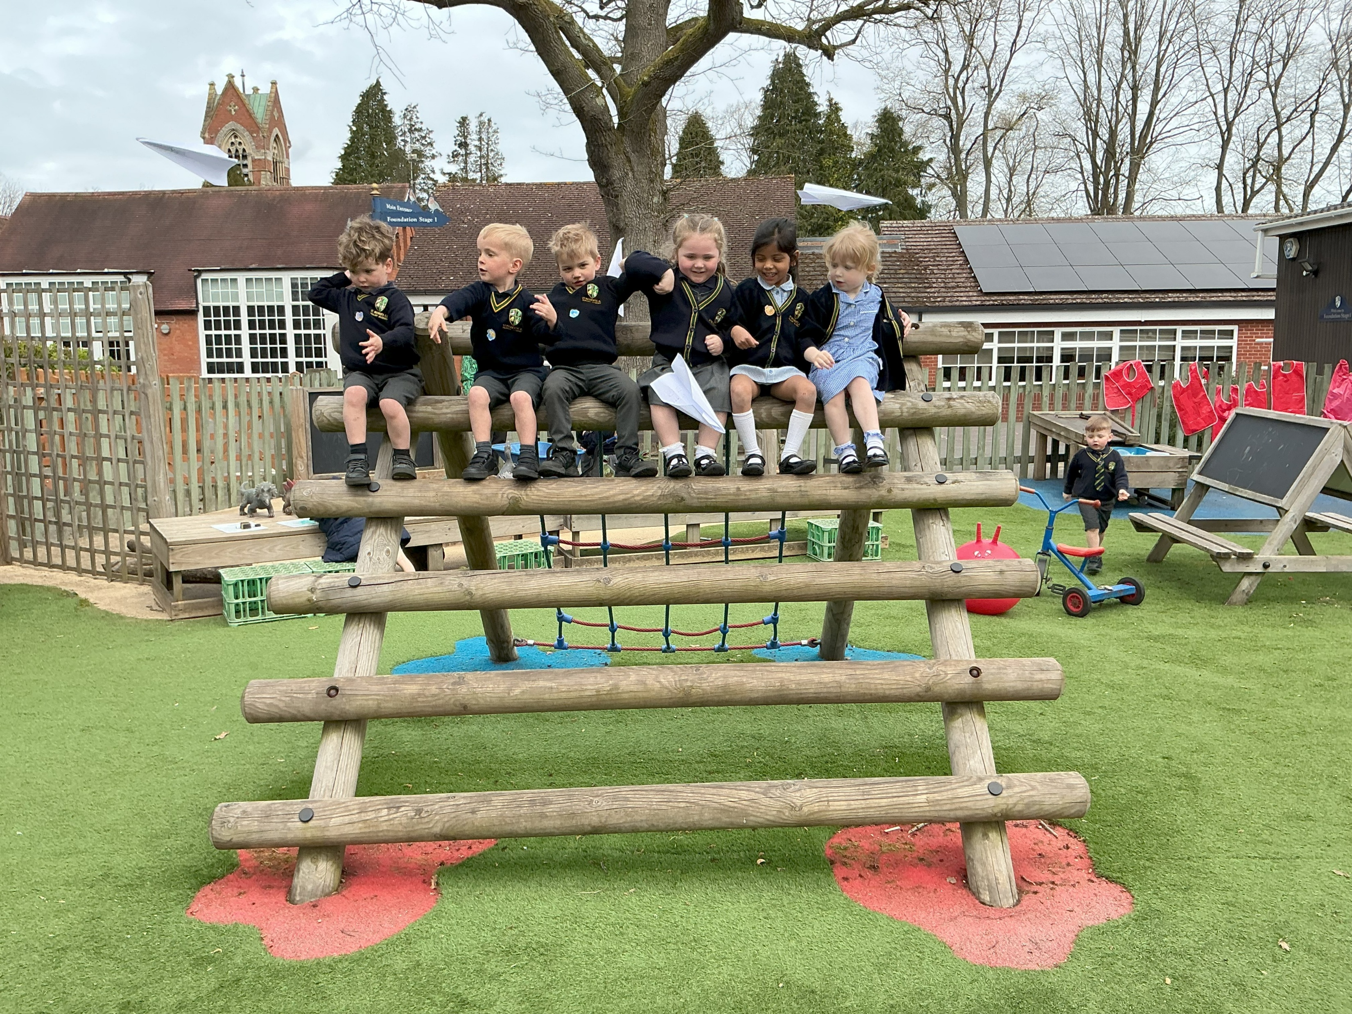
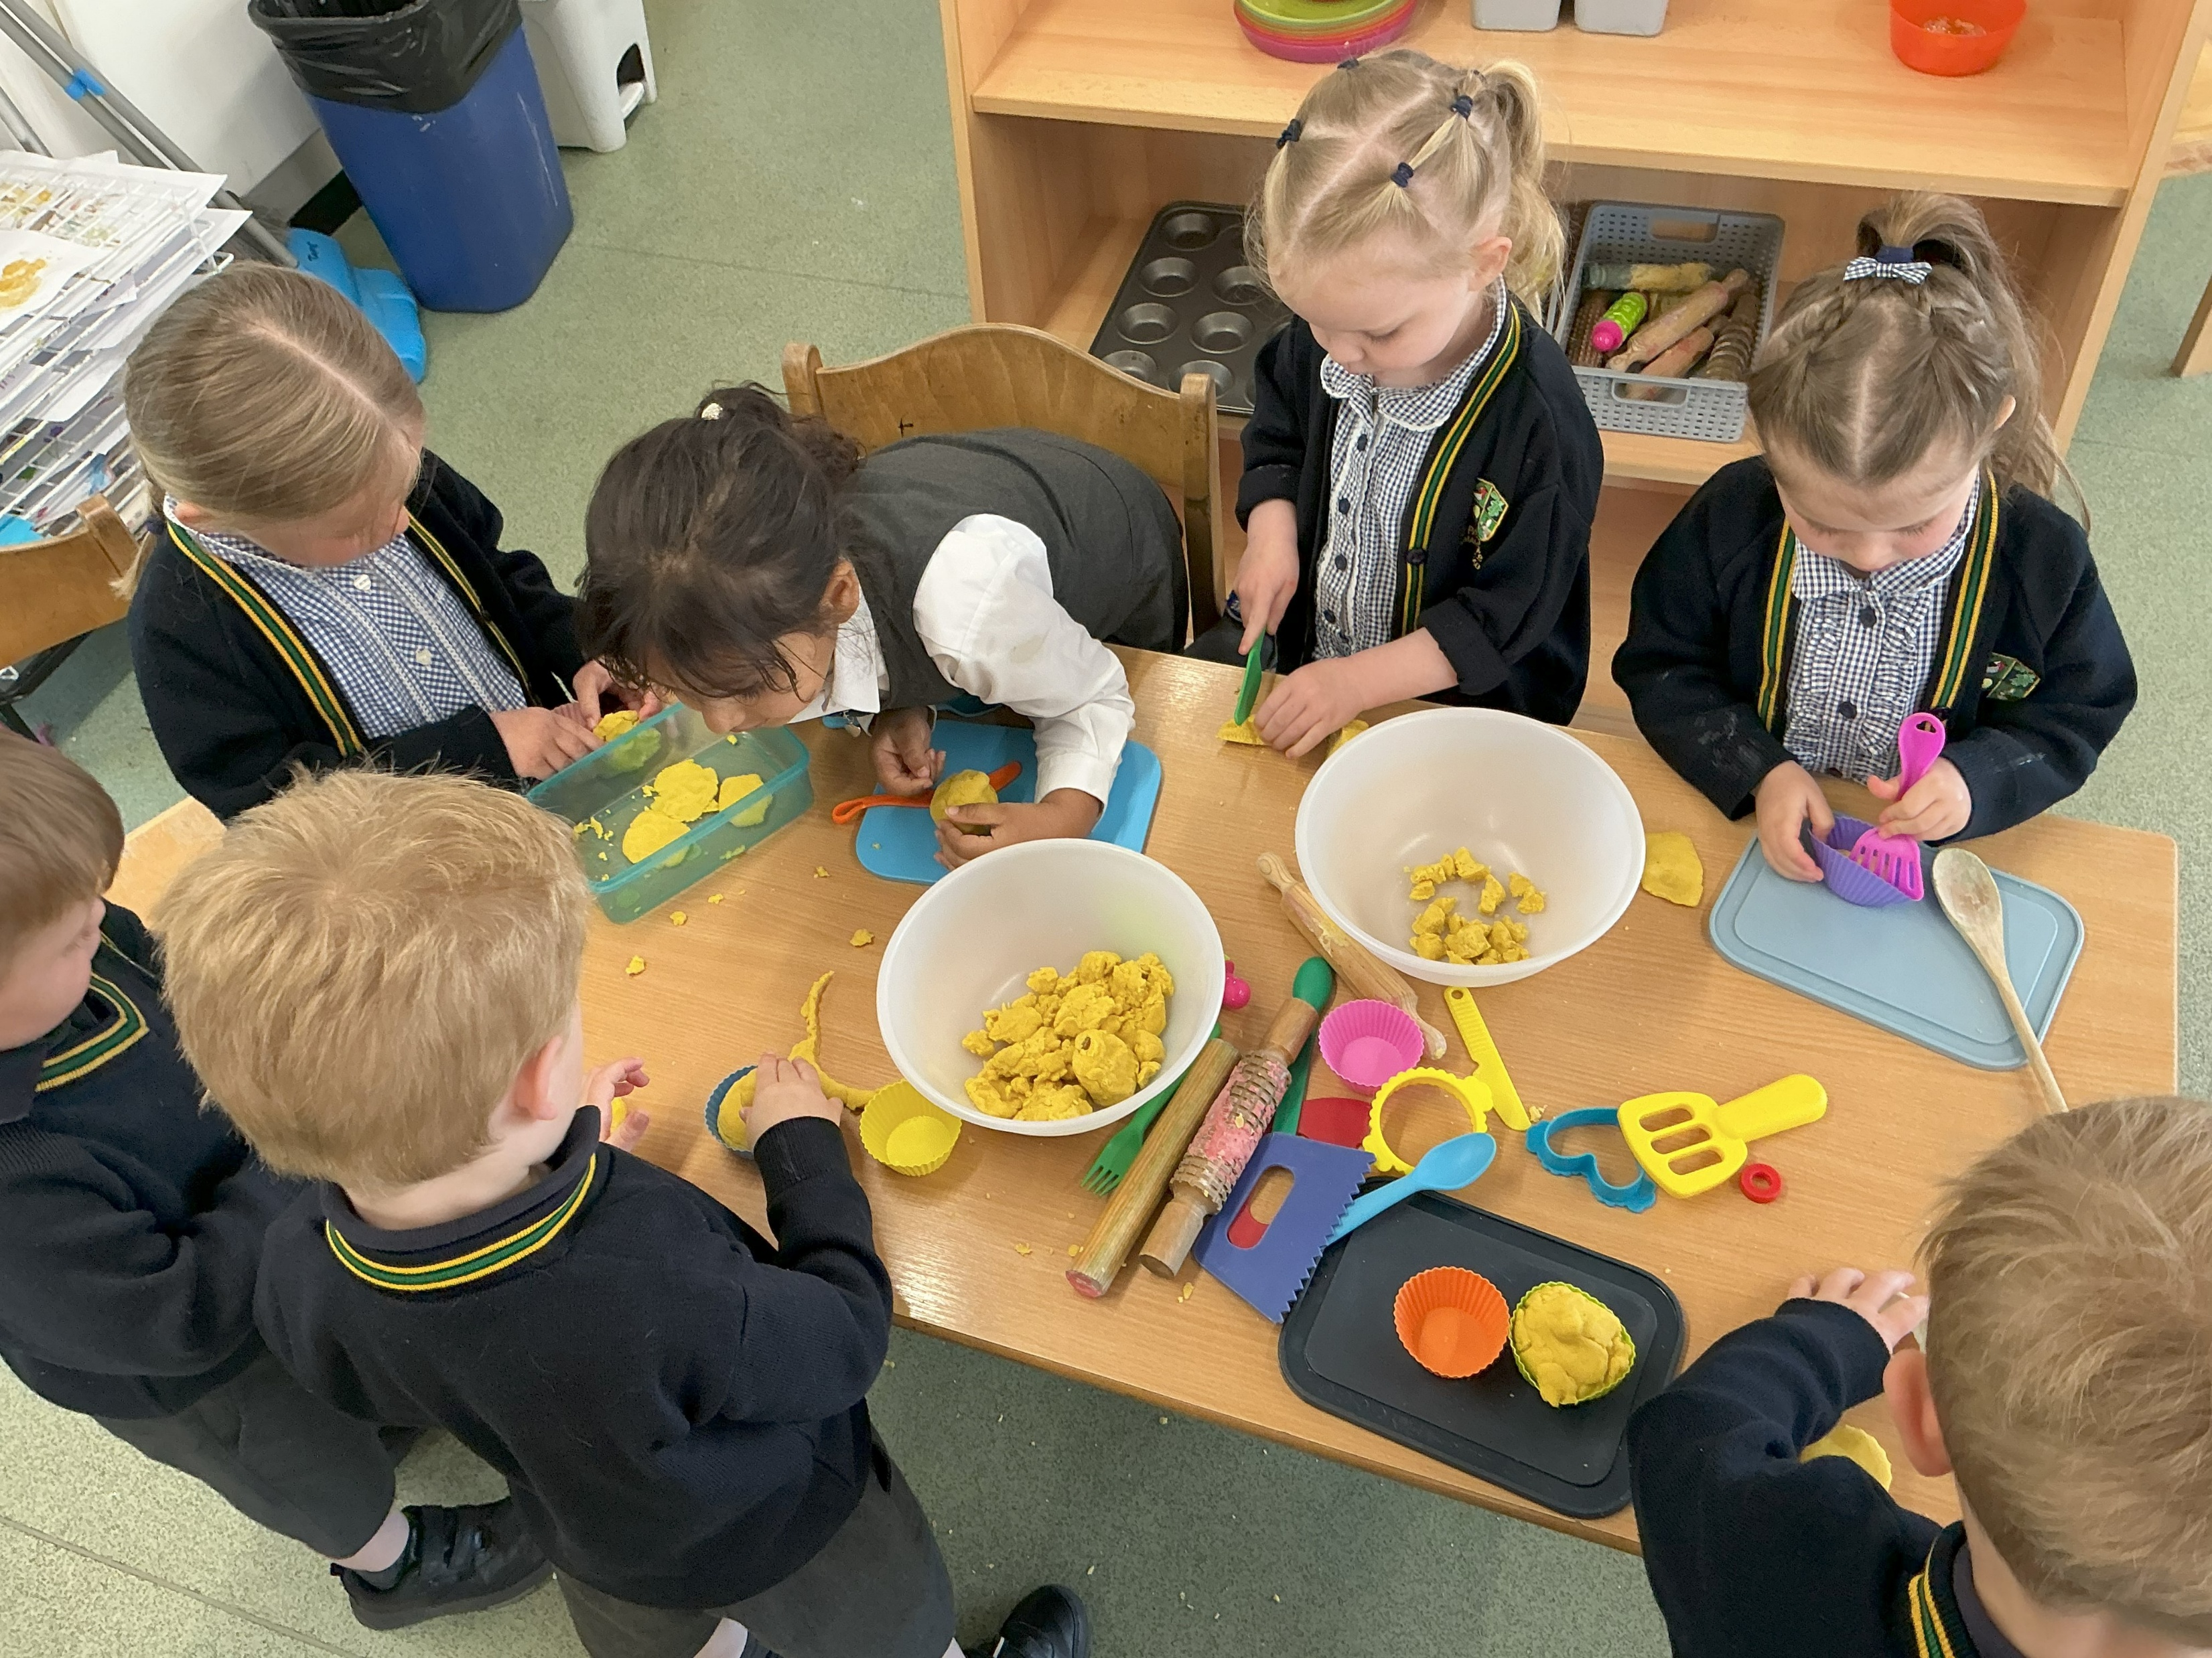
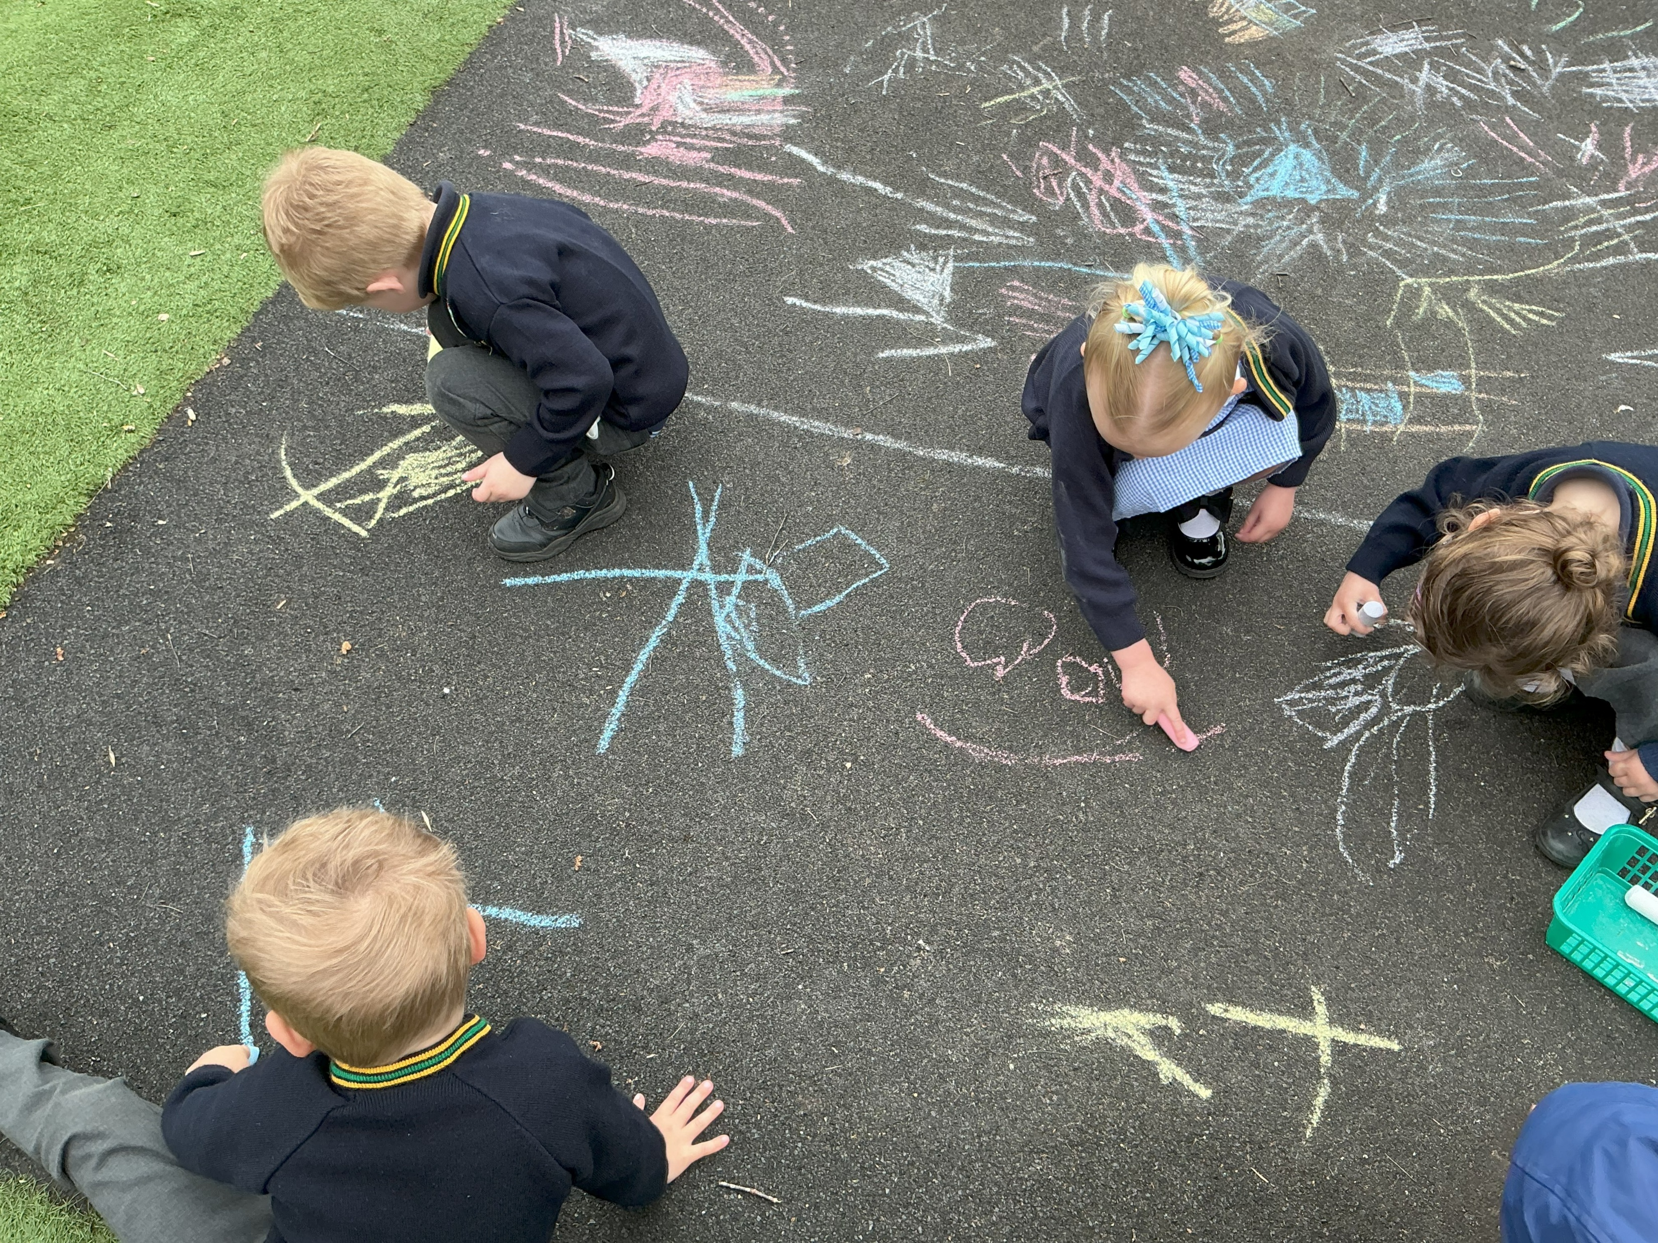
Welcome to FS1
We are the
Nursery Class!
“God’s light shines on us. We grow in love, learning and kindness to bless others.”

Slide 2
Meet the Nursery Team
Mrs Blick
Nursery Teacher EYFS Lead
Miss Benson
Nursery TA
Mighty Oaks Staff

Slide 3
Our Nursery Approach
Enjoyment is at the heart of everything we do
We create a safe, happy environment where children are ready to learn
Learning is guided by children’s interests through play and exploration
We encourage children to ask questions, explore, and discover
We support children when they need help, building confidence and independence

Slide 4
Our Nursery Vision
To inspire curiosity and a love of learning
To recognise and celebrate each child’s individual strengths
To work in partnership with parents to help every child reach their full potential
Our Aims for Every Child
Safe and happy learners
Learning through play and exploration
Developing confidence and independence
Positive relationships
Preparing children for Reception

Slide 5
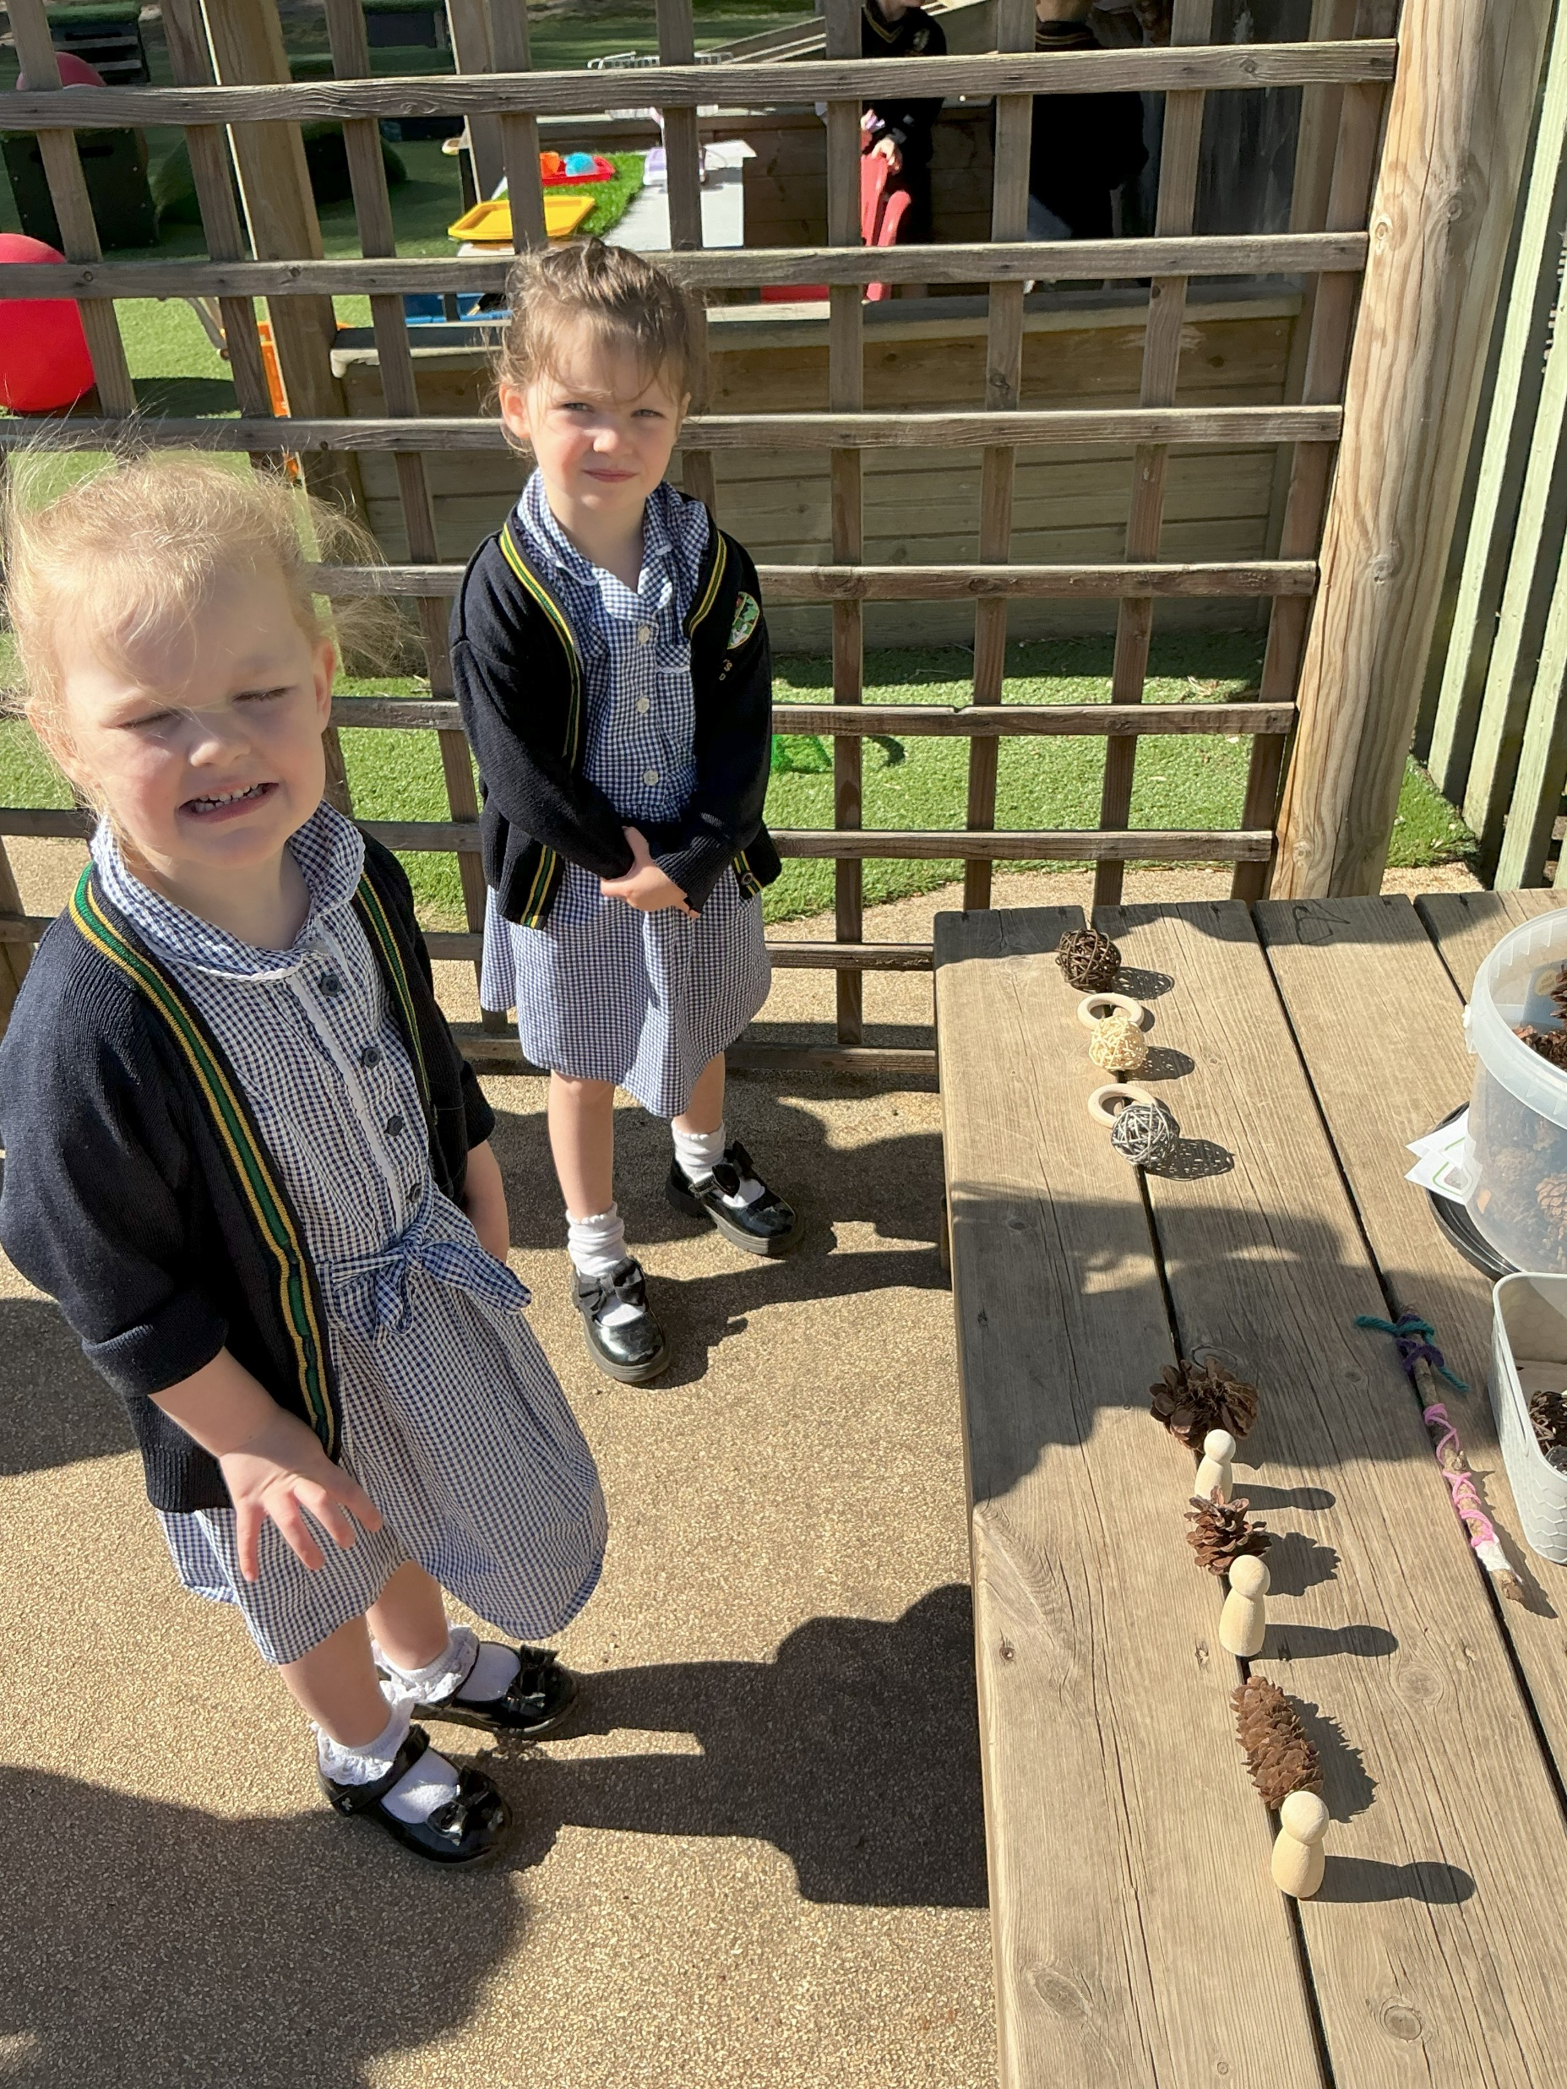
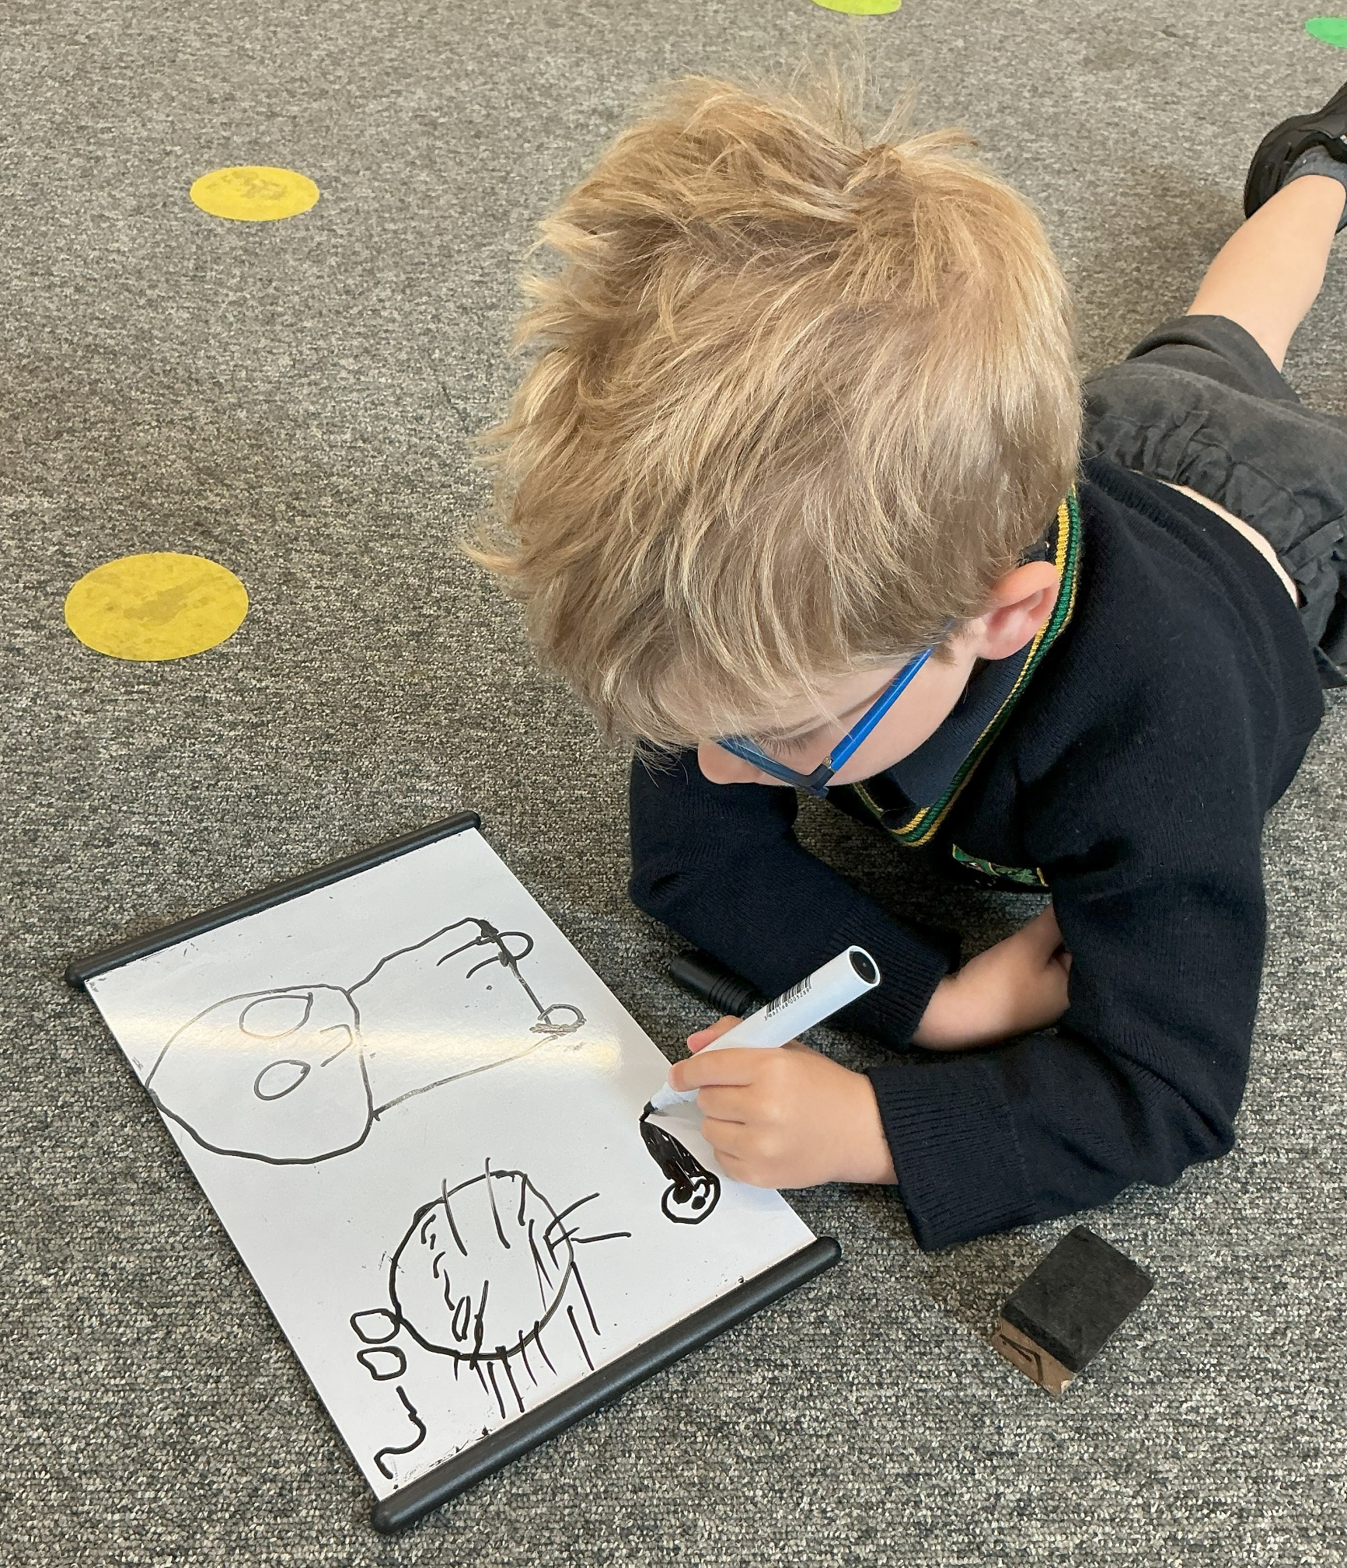
Learning in Nursery
Prime Areas
Personal, Social and Emotional
Physical Development
Communication and Language
Specific Areas
Literacy
Mathematics
Understanding the World
Expressive Arts and Design

Slide 6
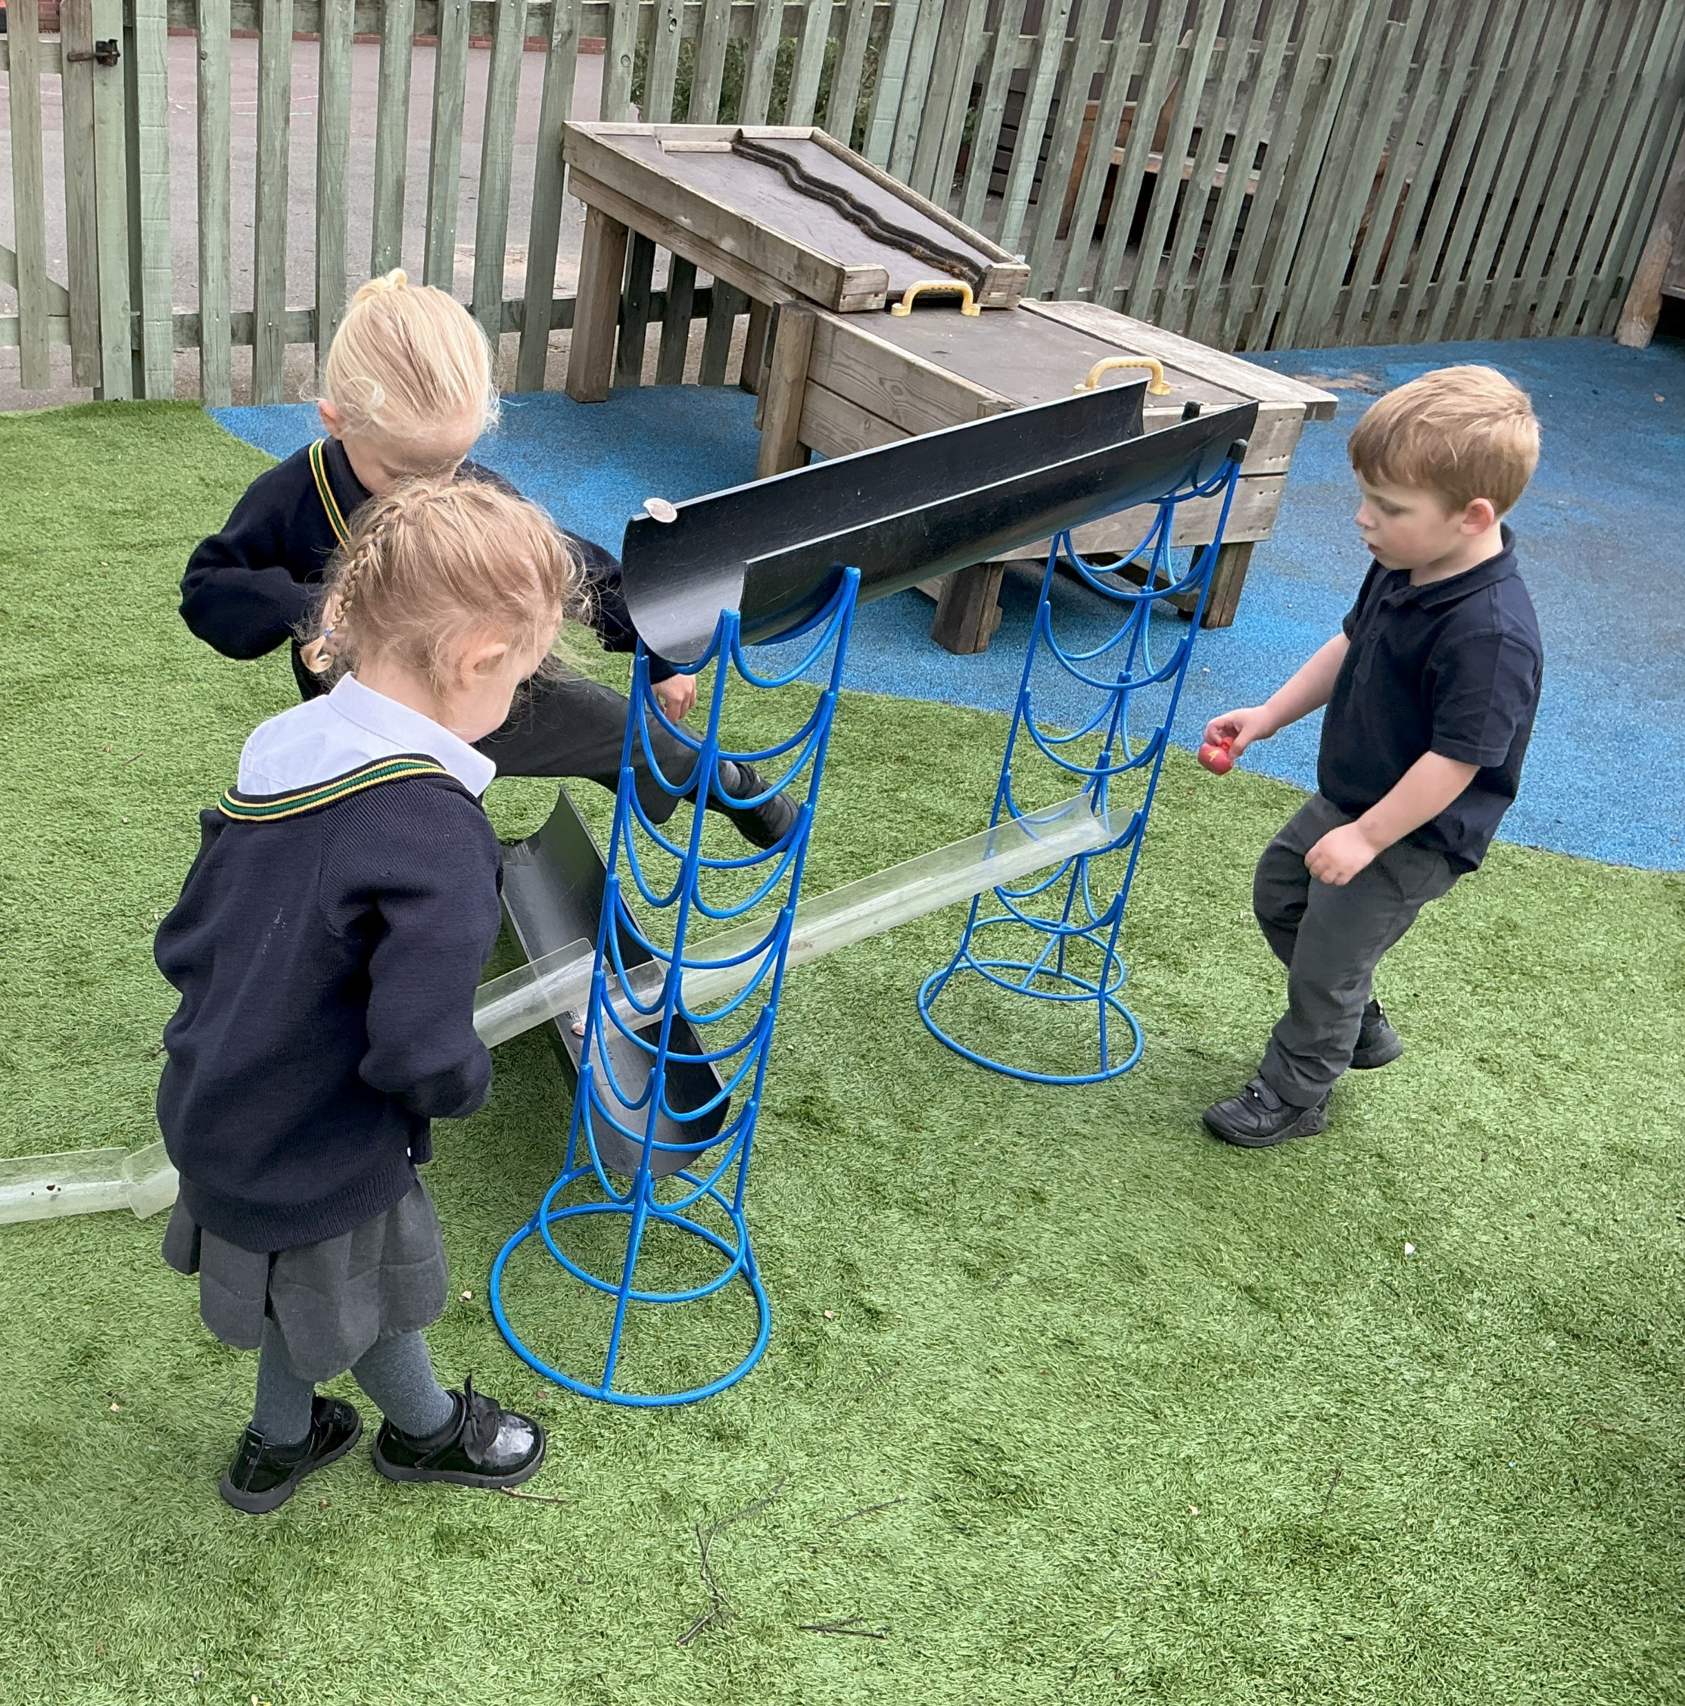
Communication & Language
Listening, Attention and Understanding
Speaking

Slide 7
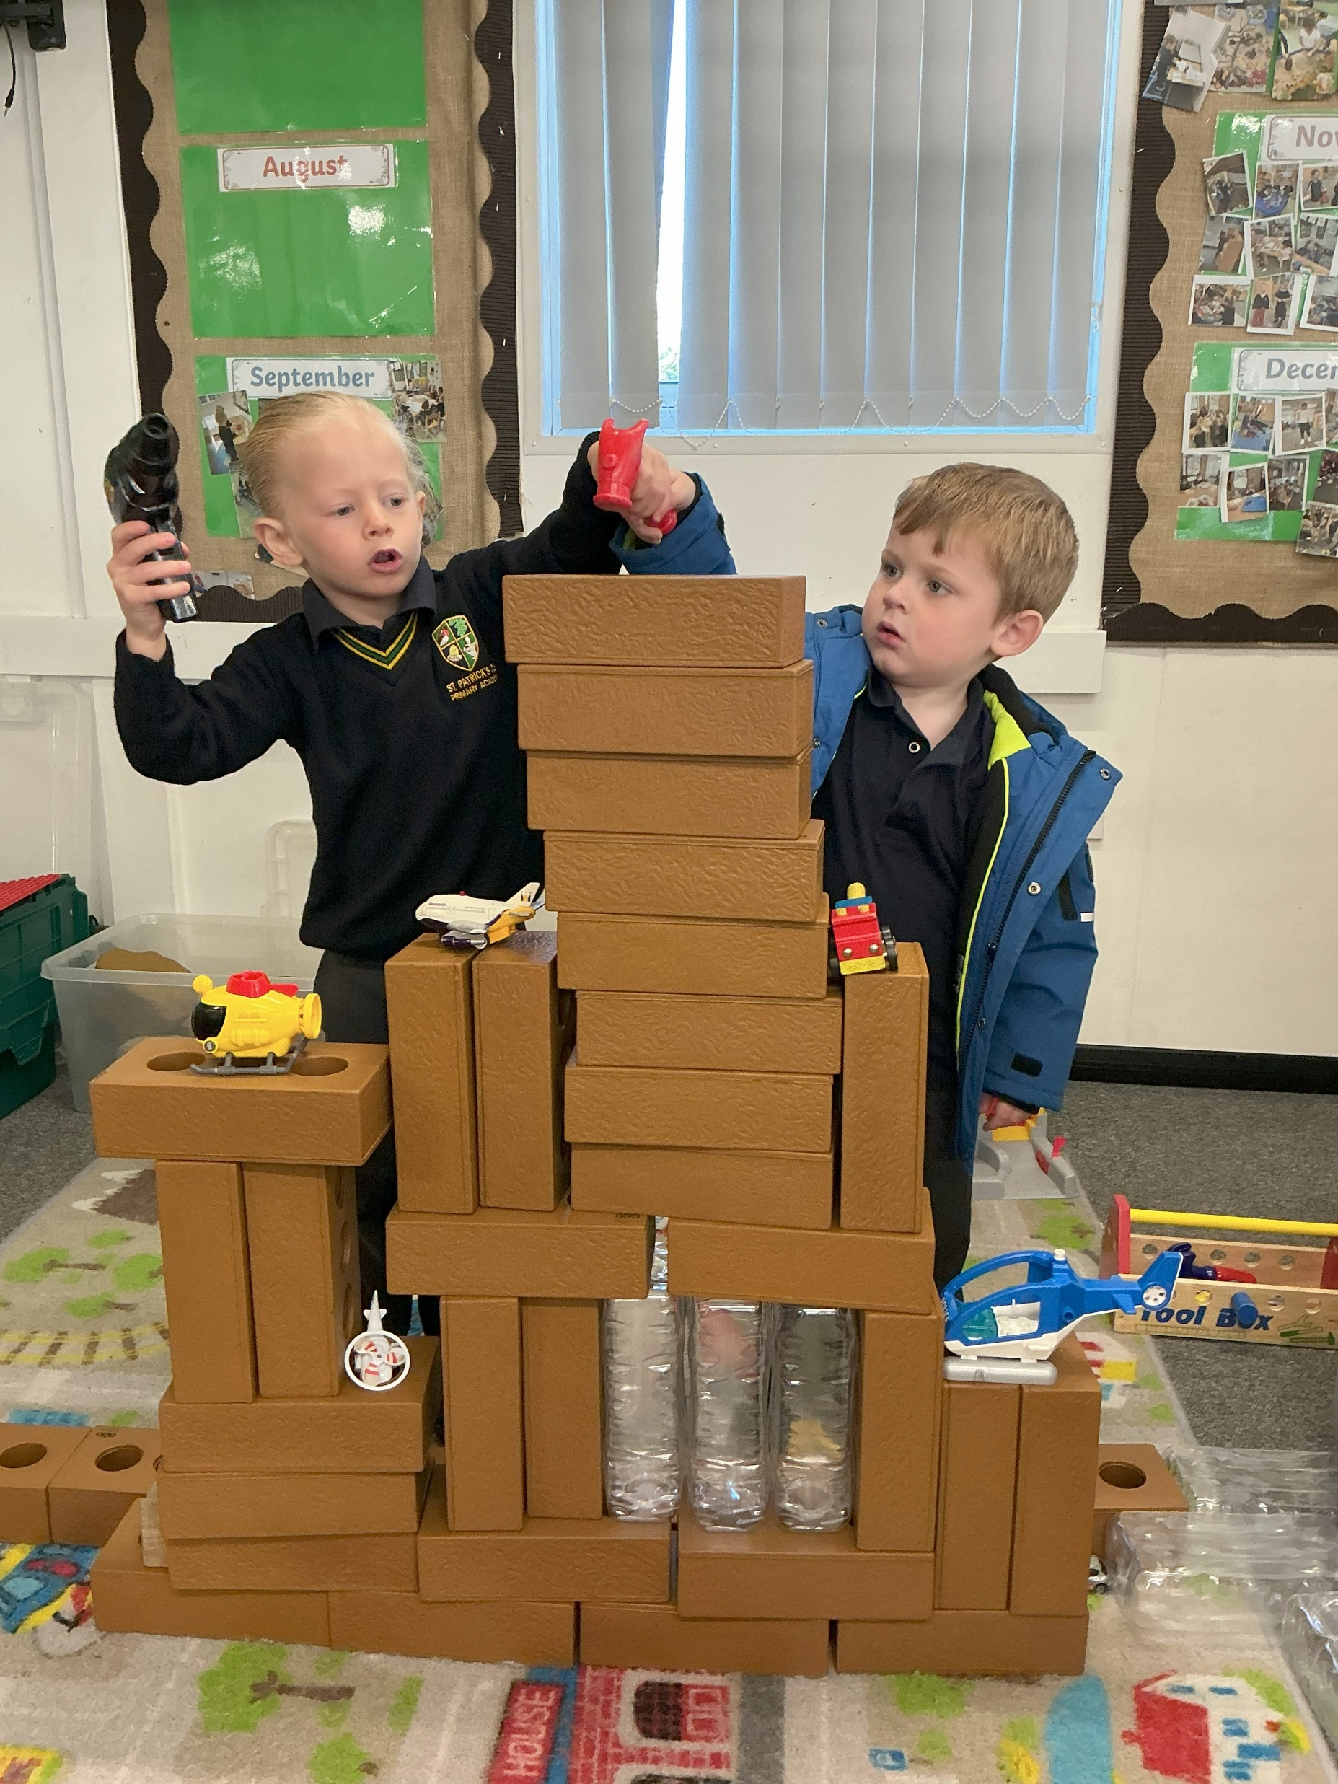
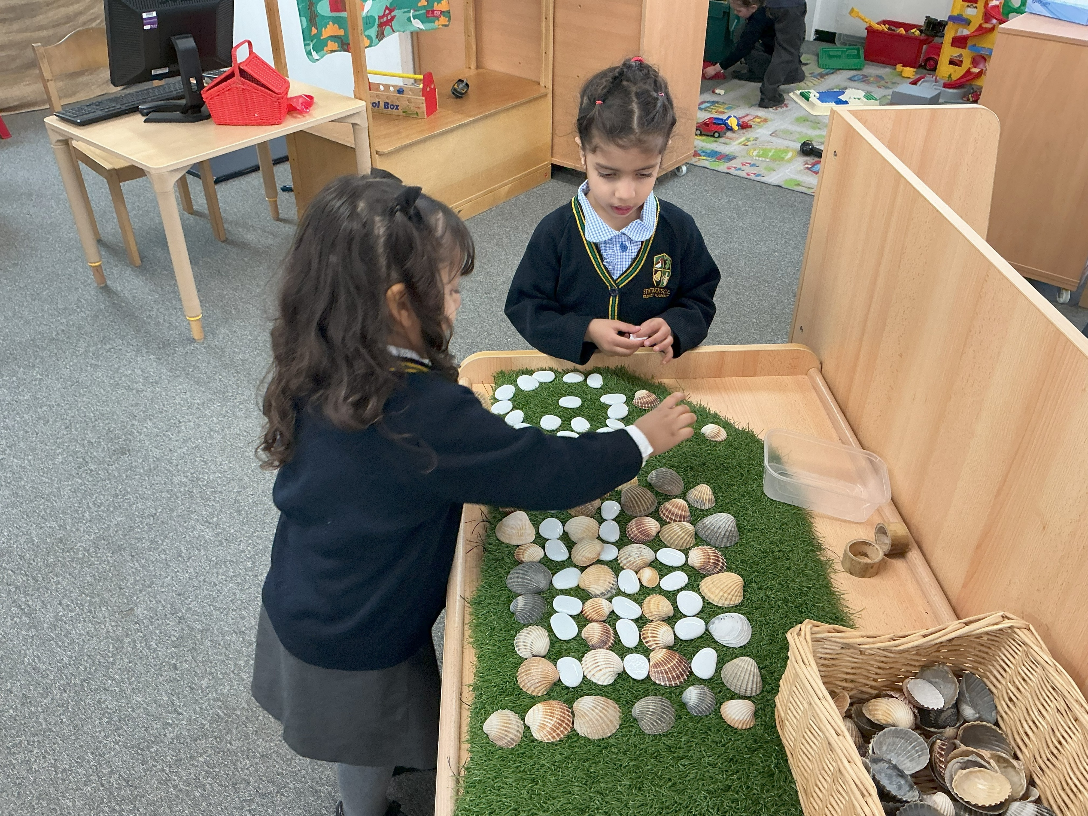
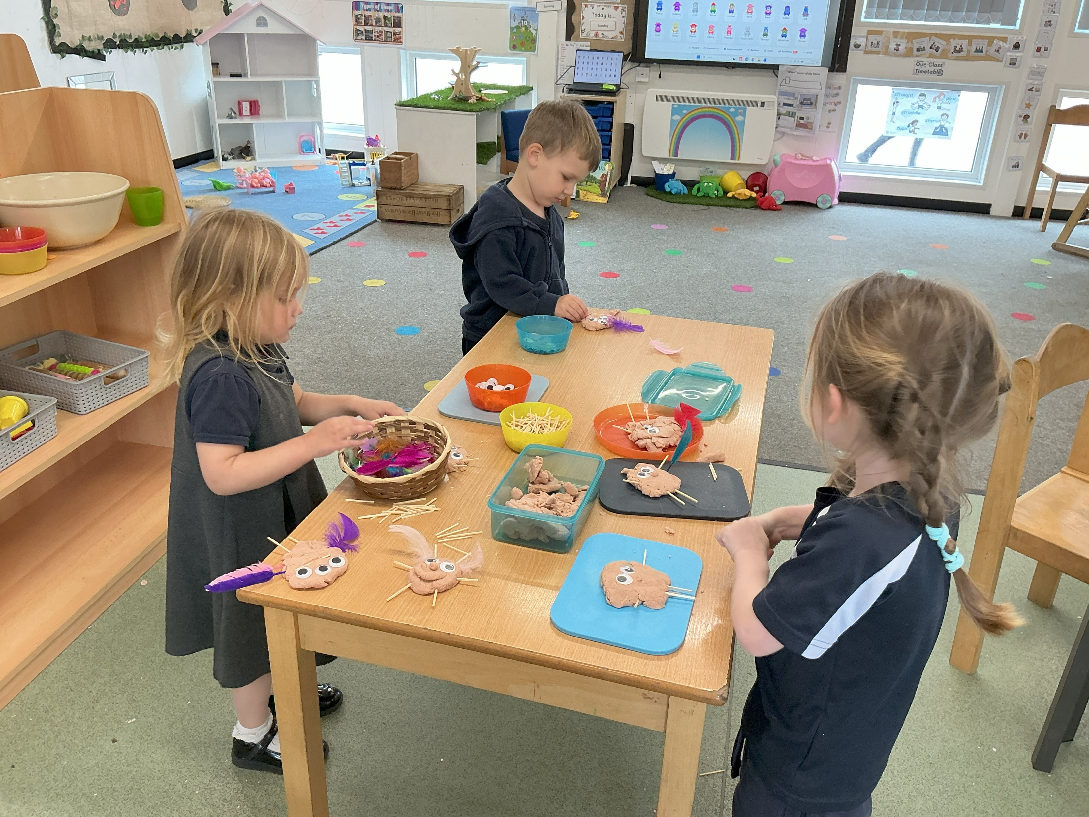
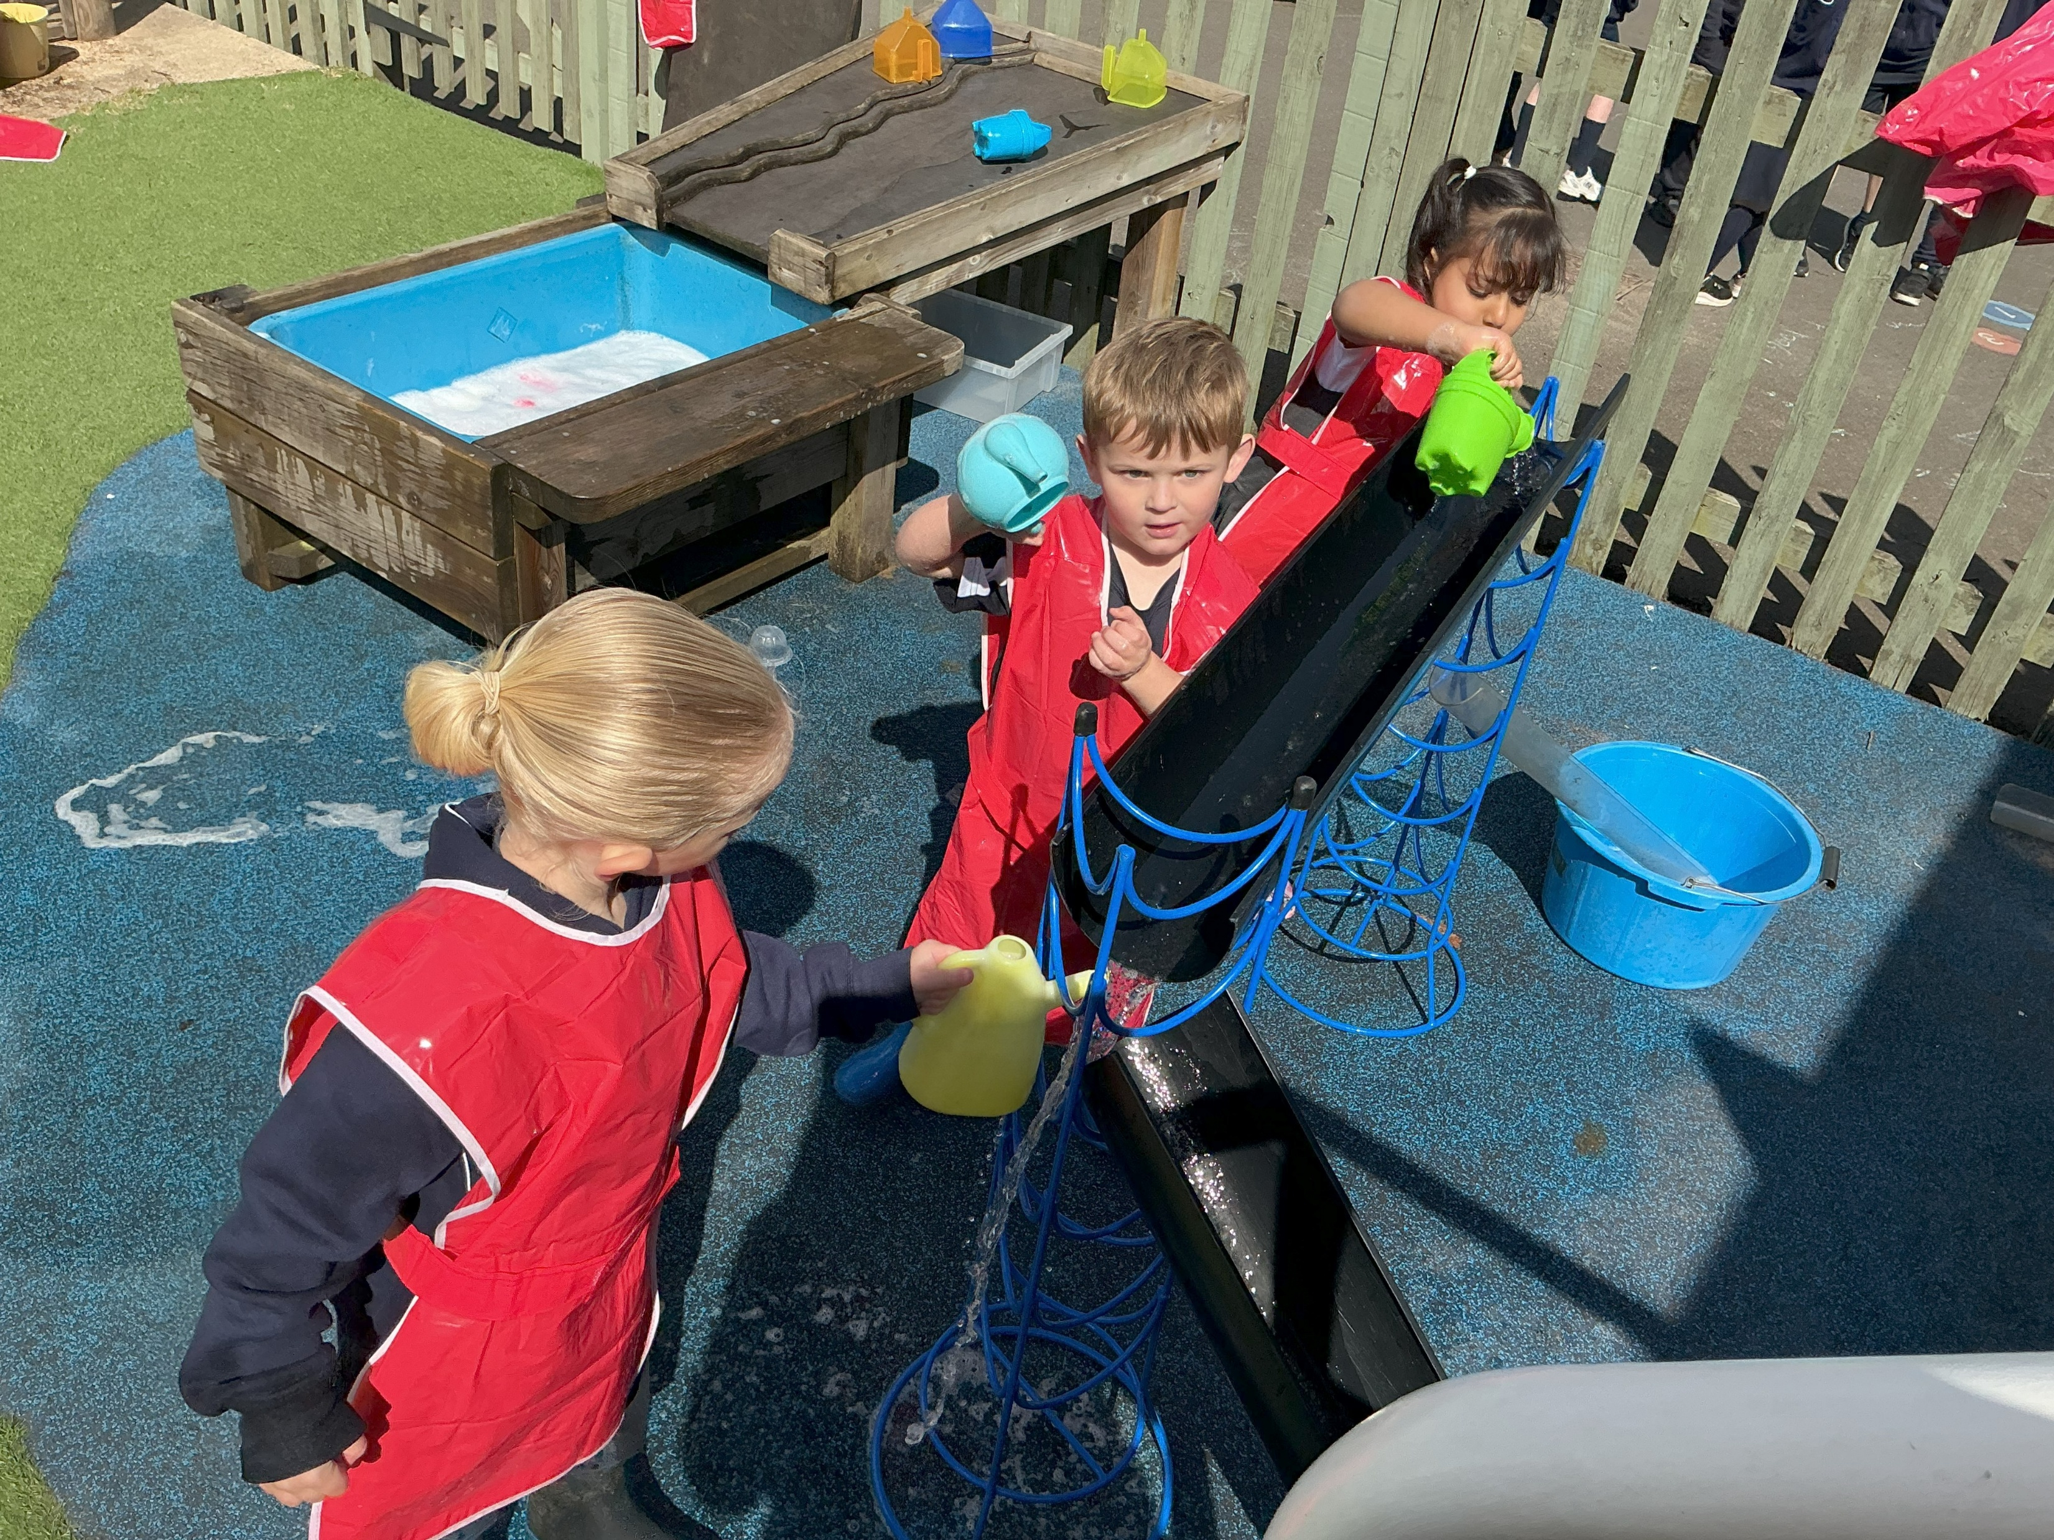
Personal, Social & Emotional Development
Self-regulation
Managing self
Building relationships

Slide 8
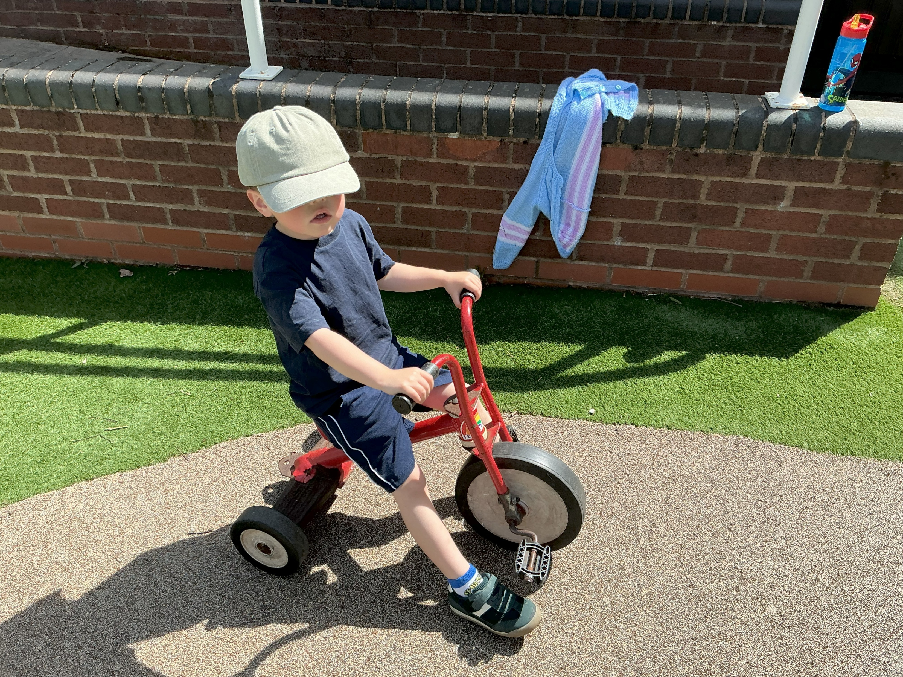
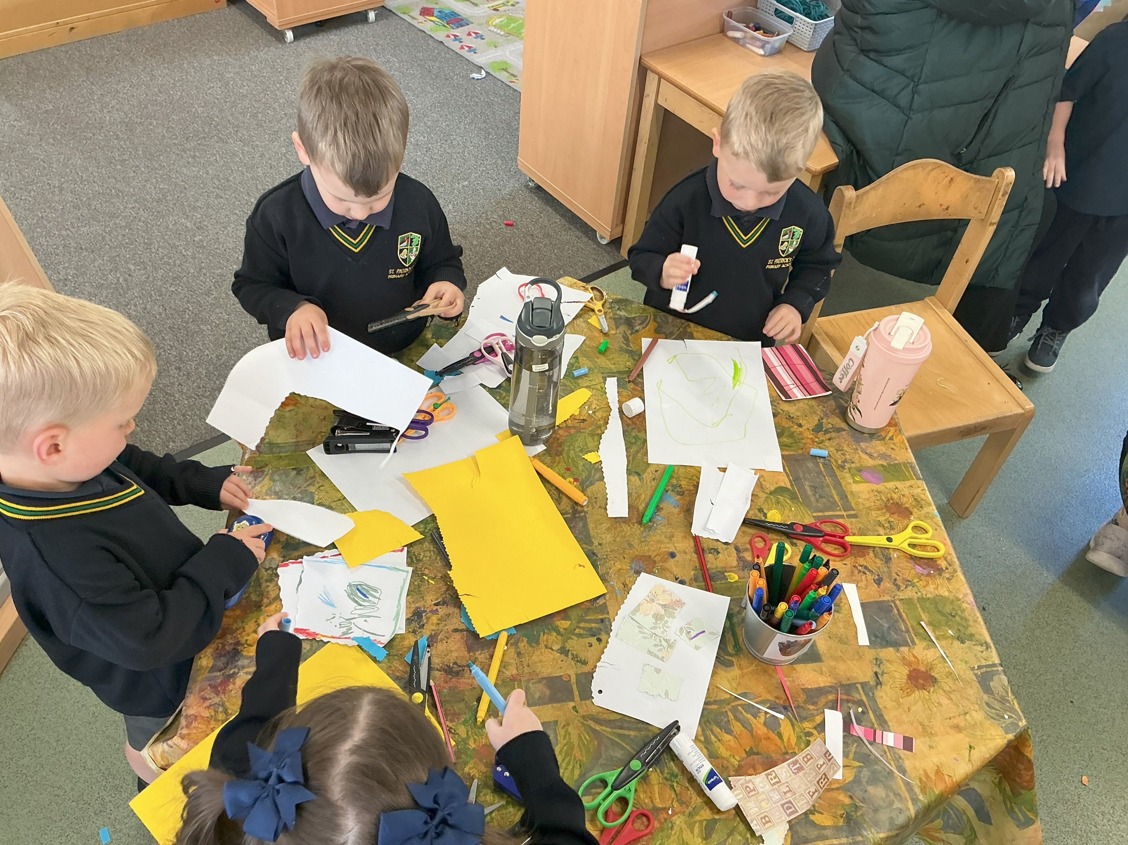
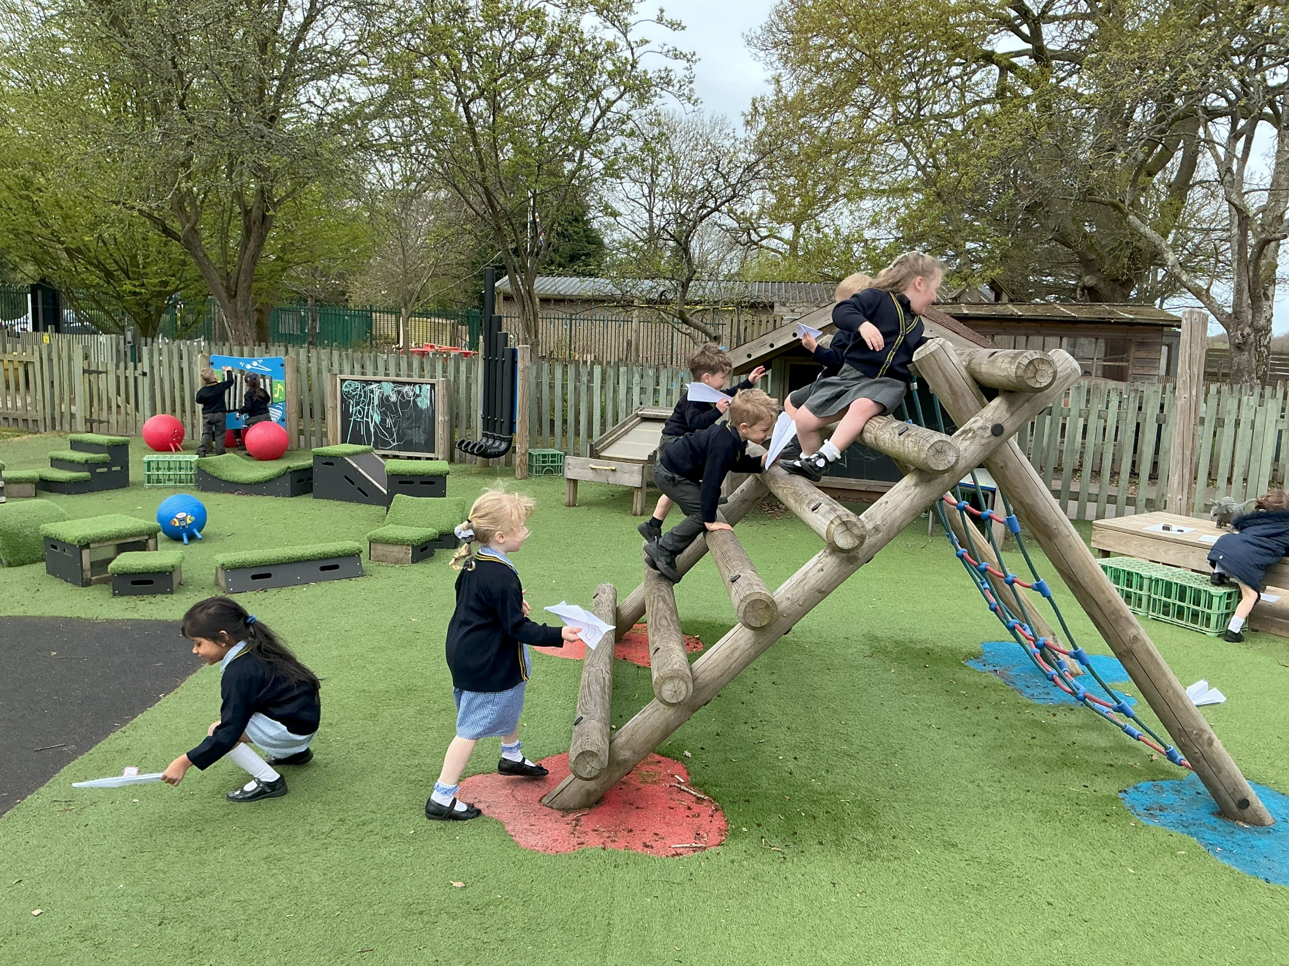
Physical Development
Gross Motor Skills
Fine motor skills

Slide 9
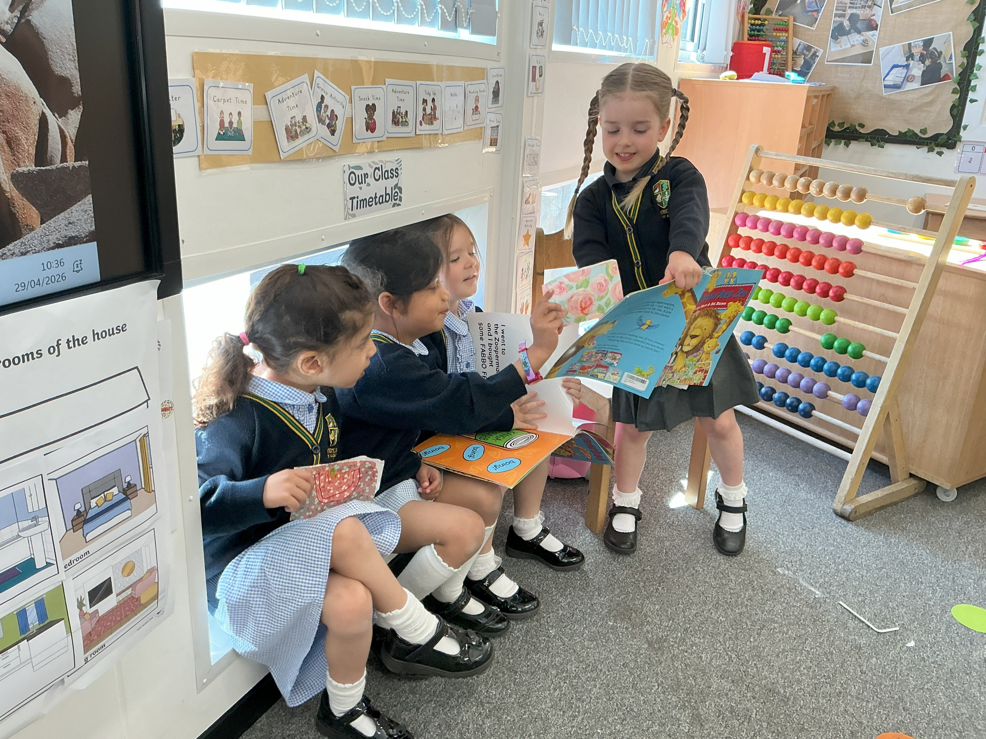
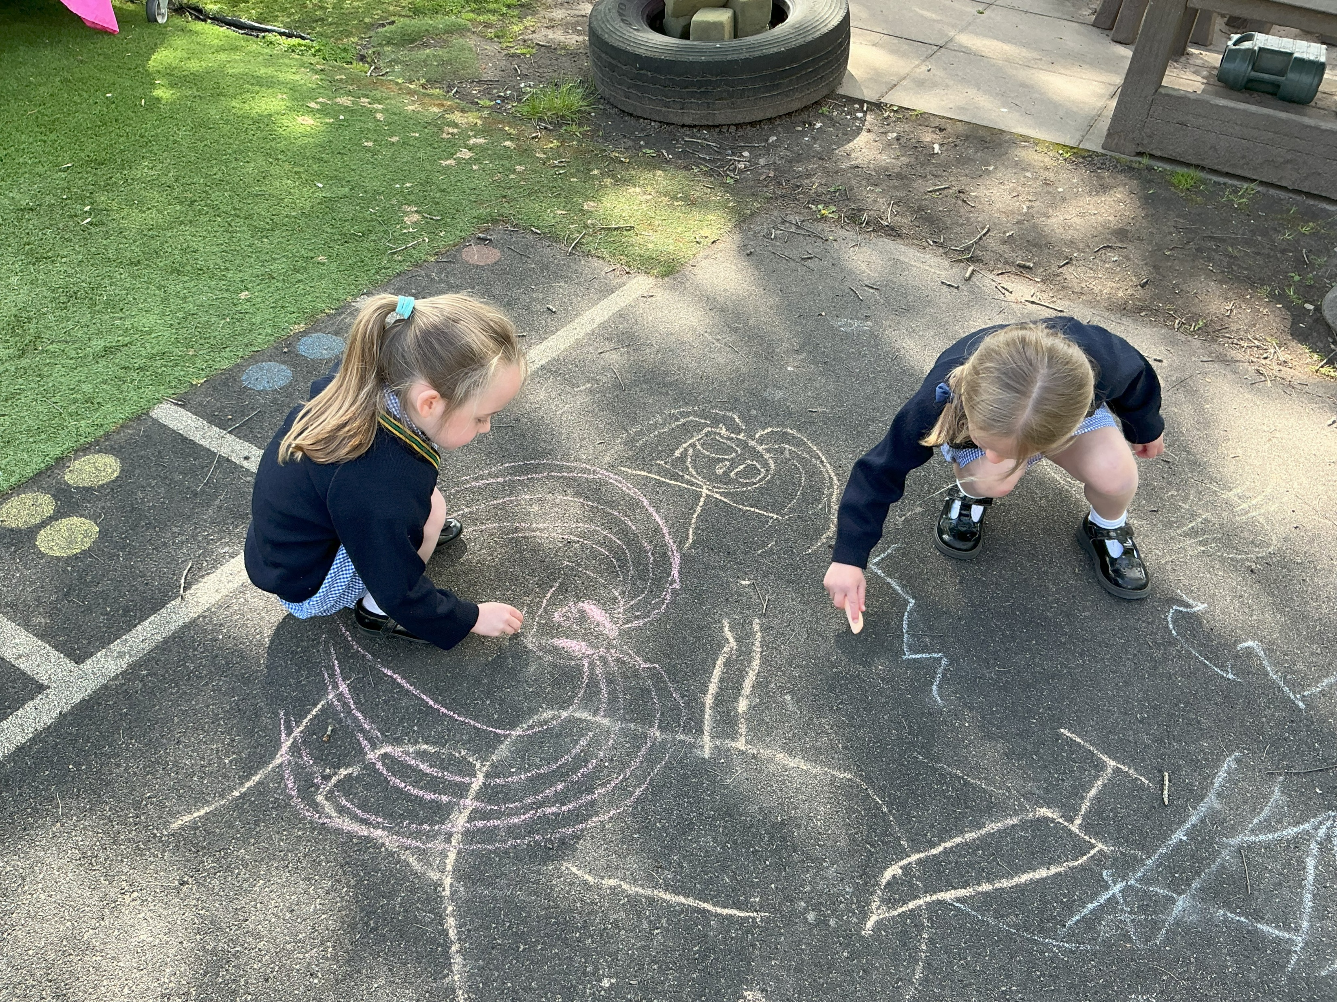
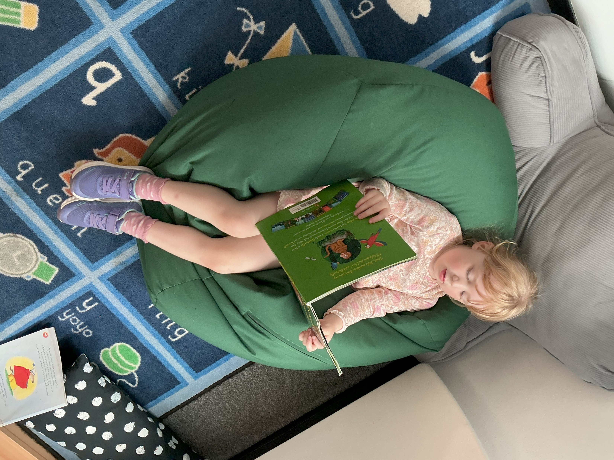
Literacy
Comprehension
Word Reading
Writing

Slide 10
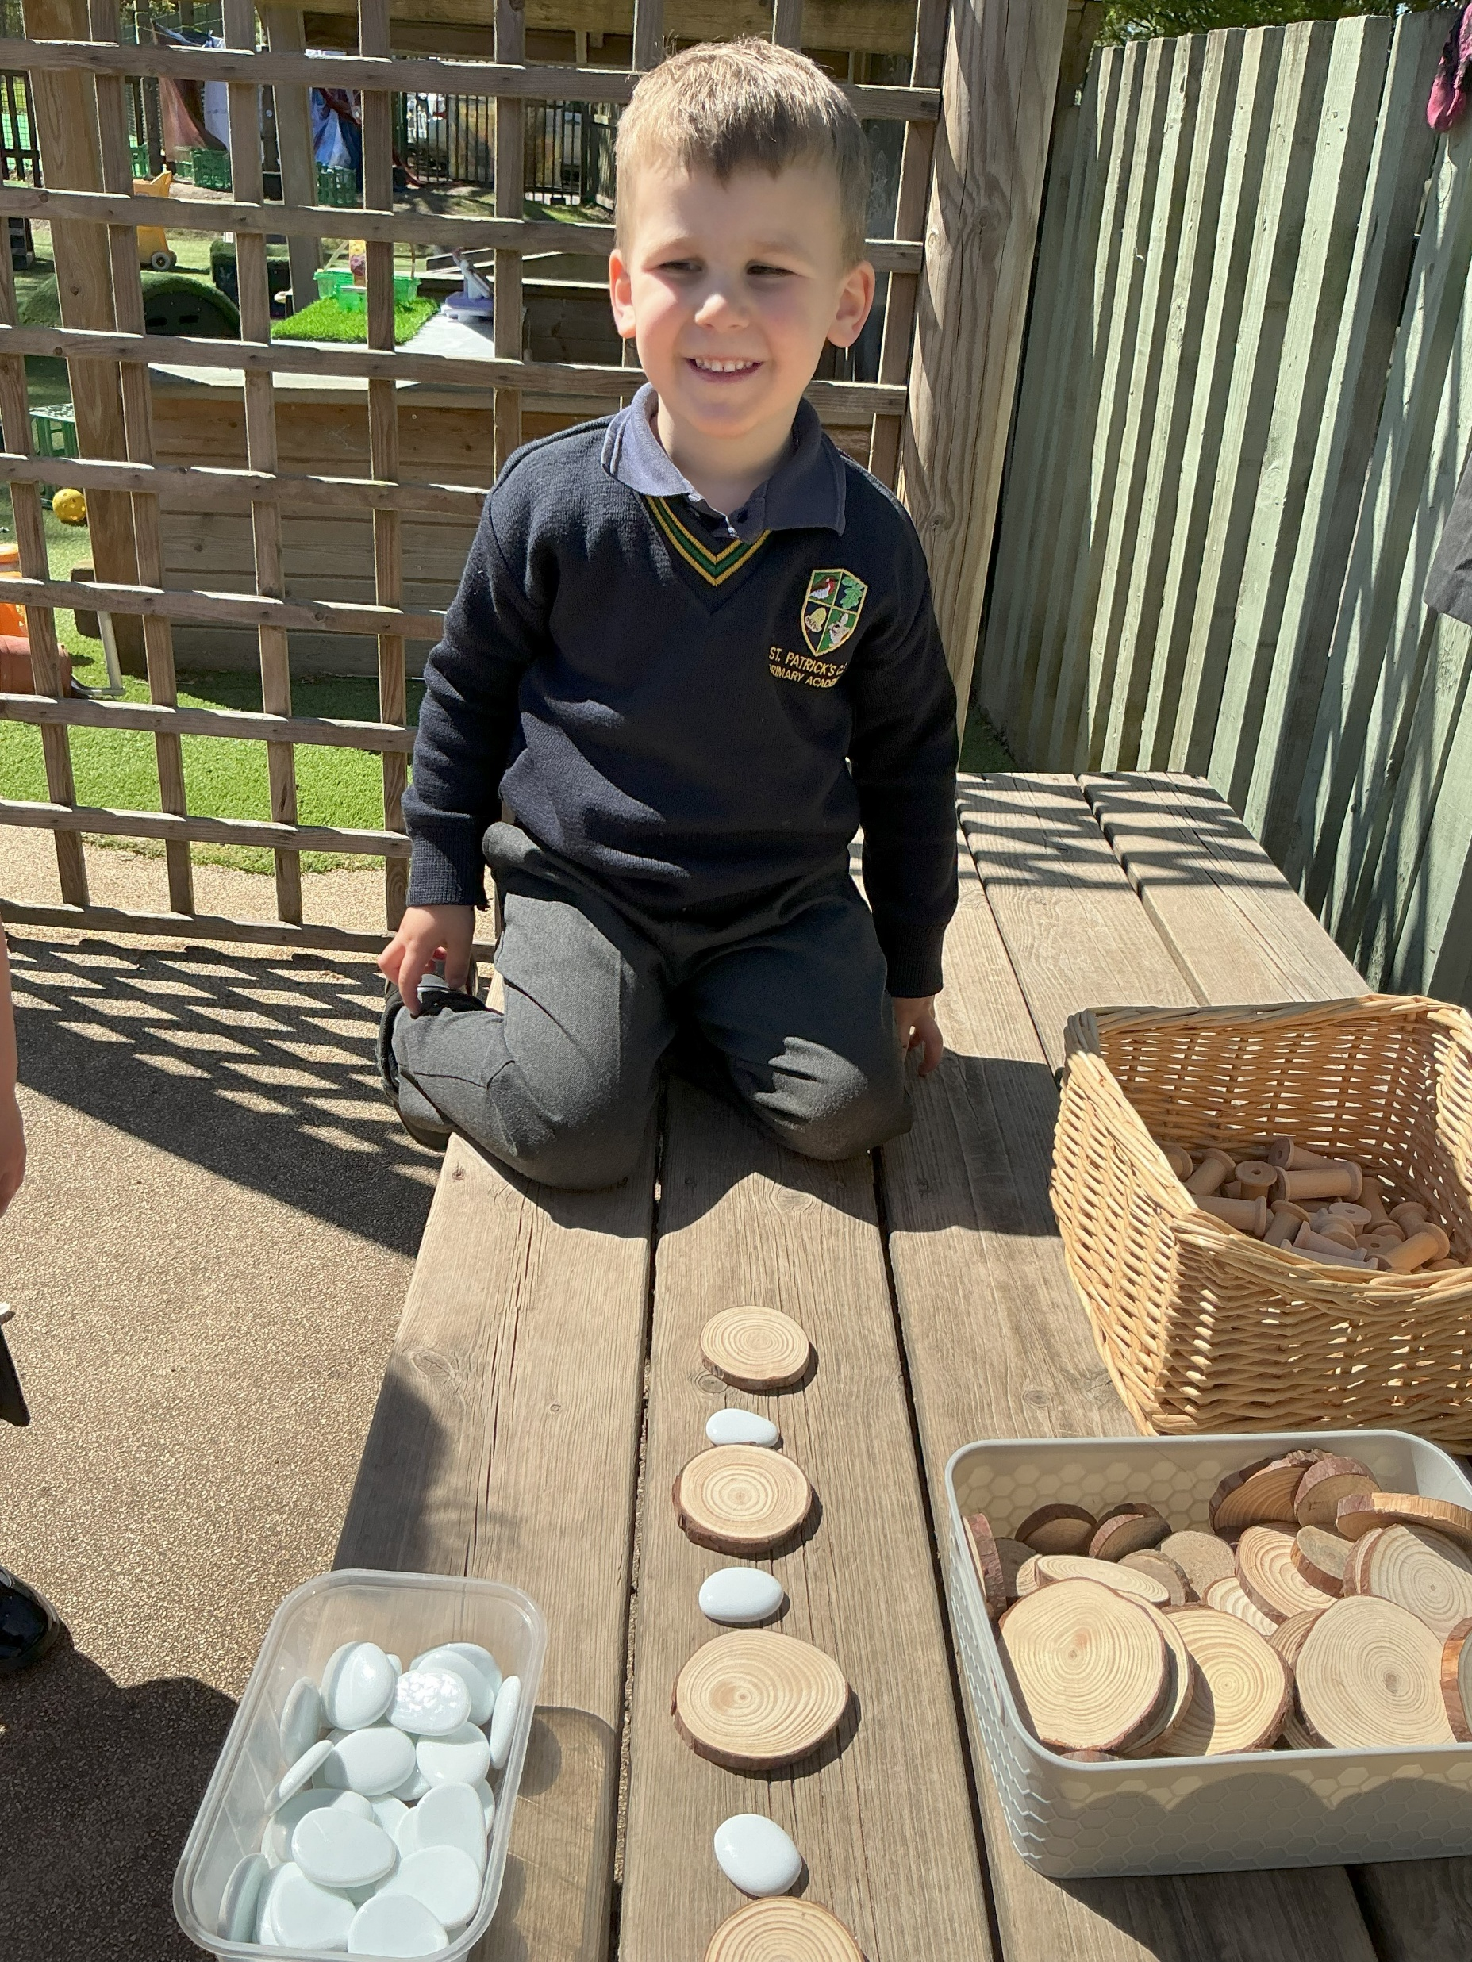
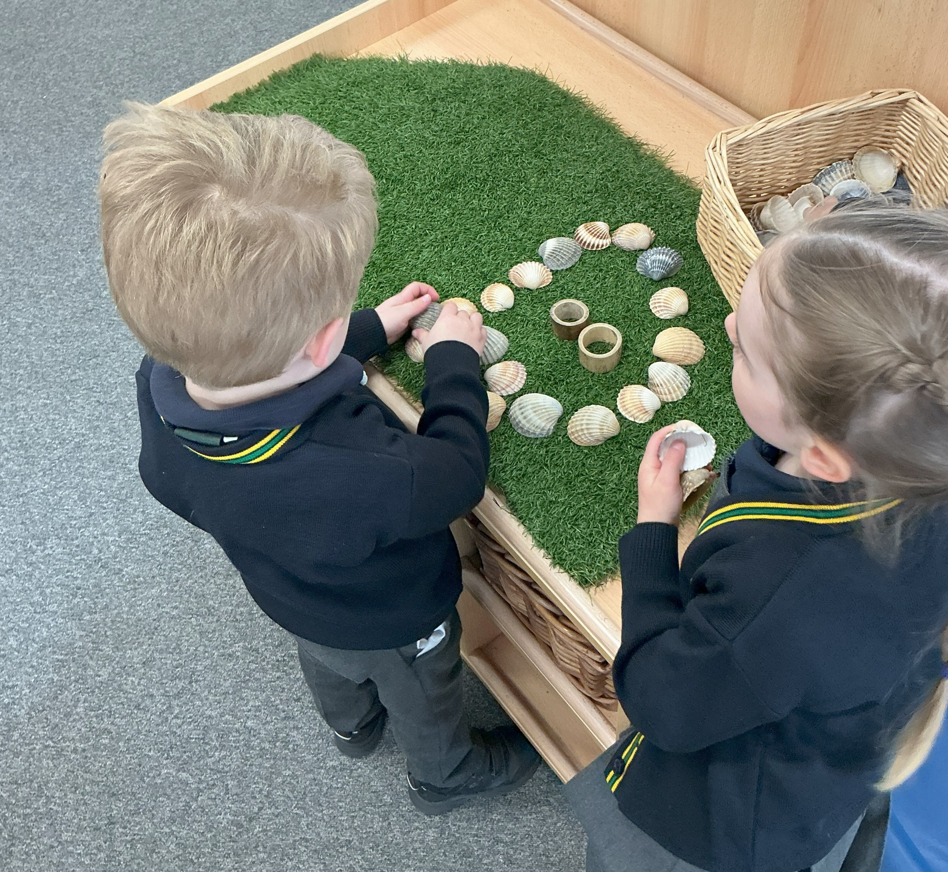
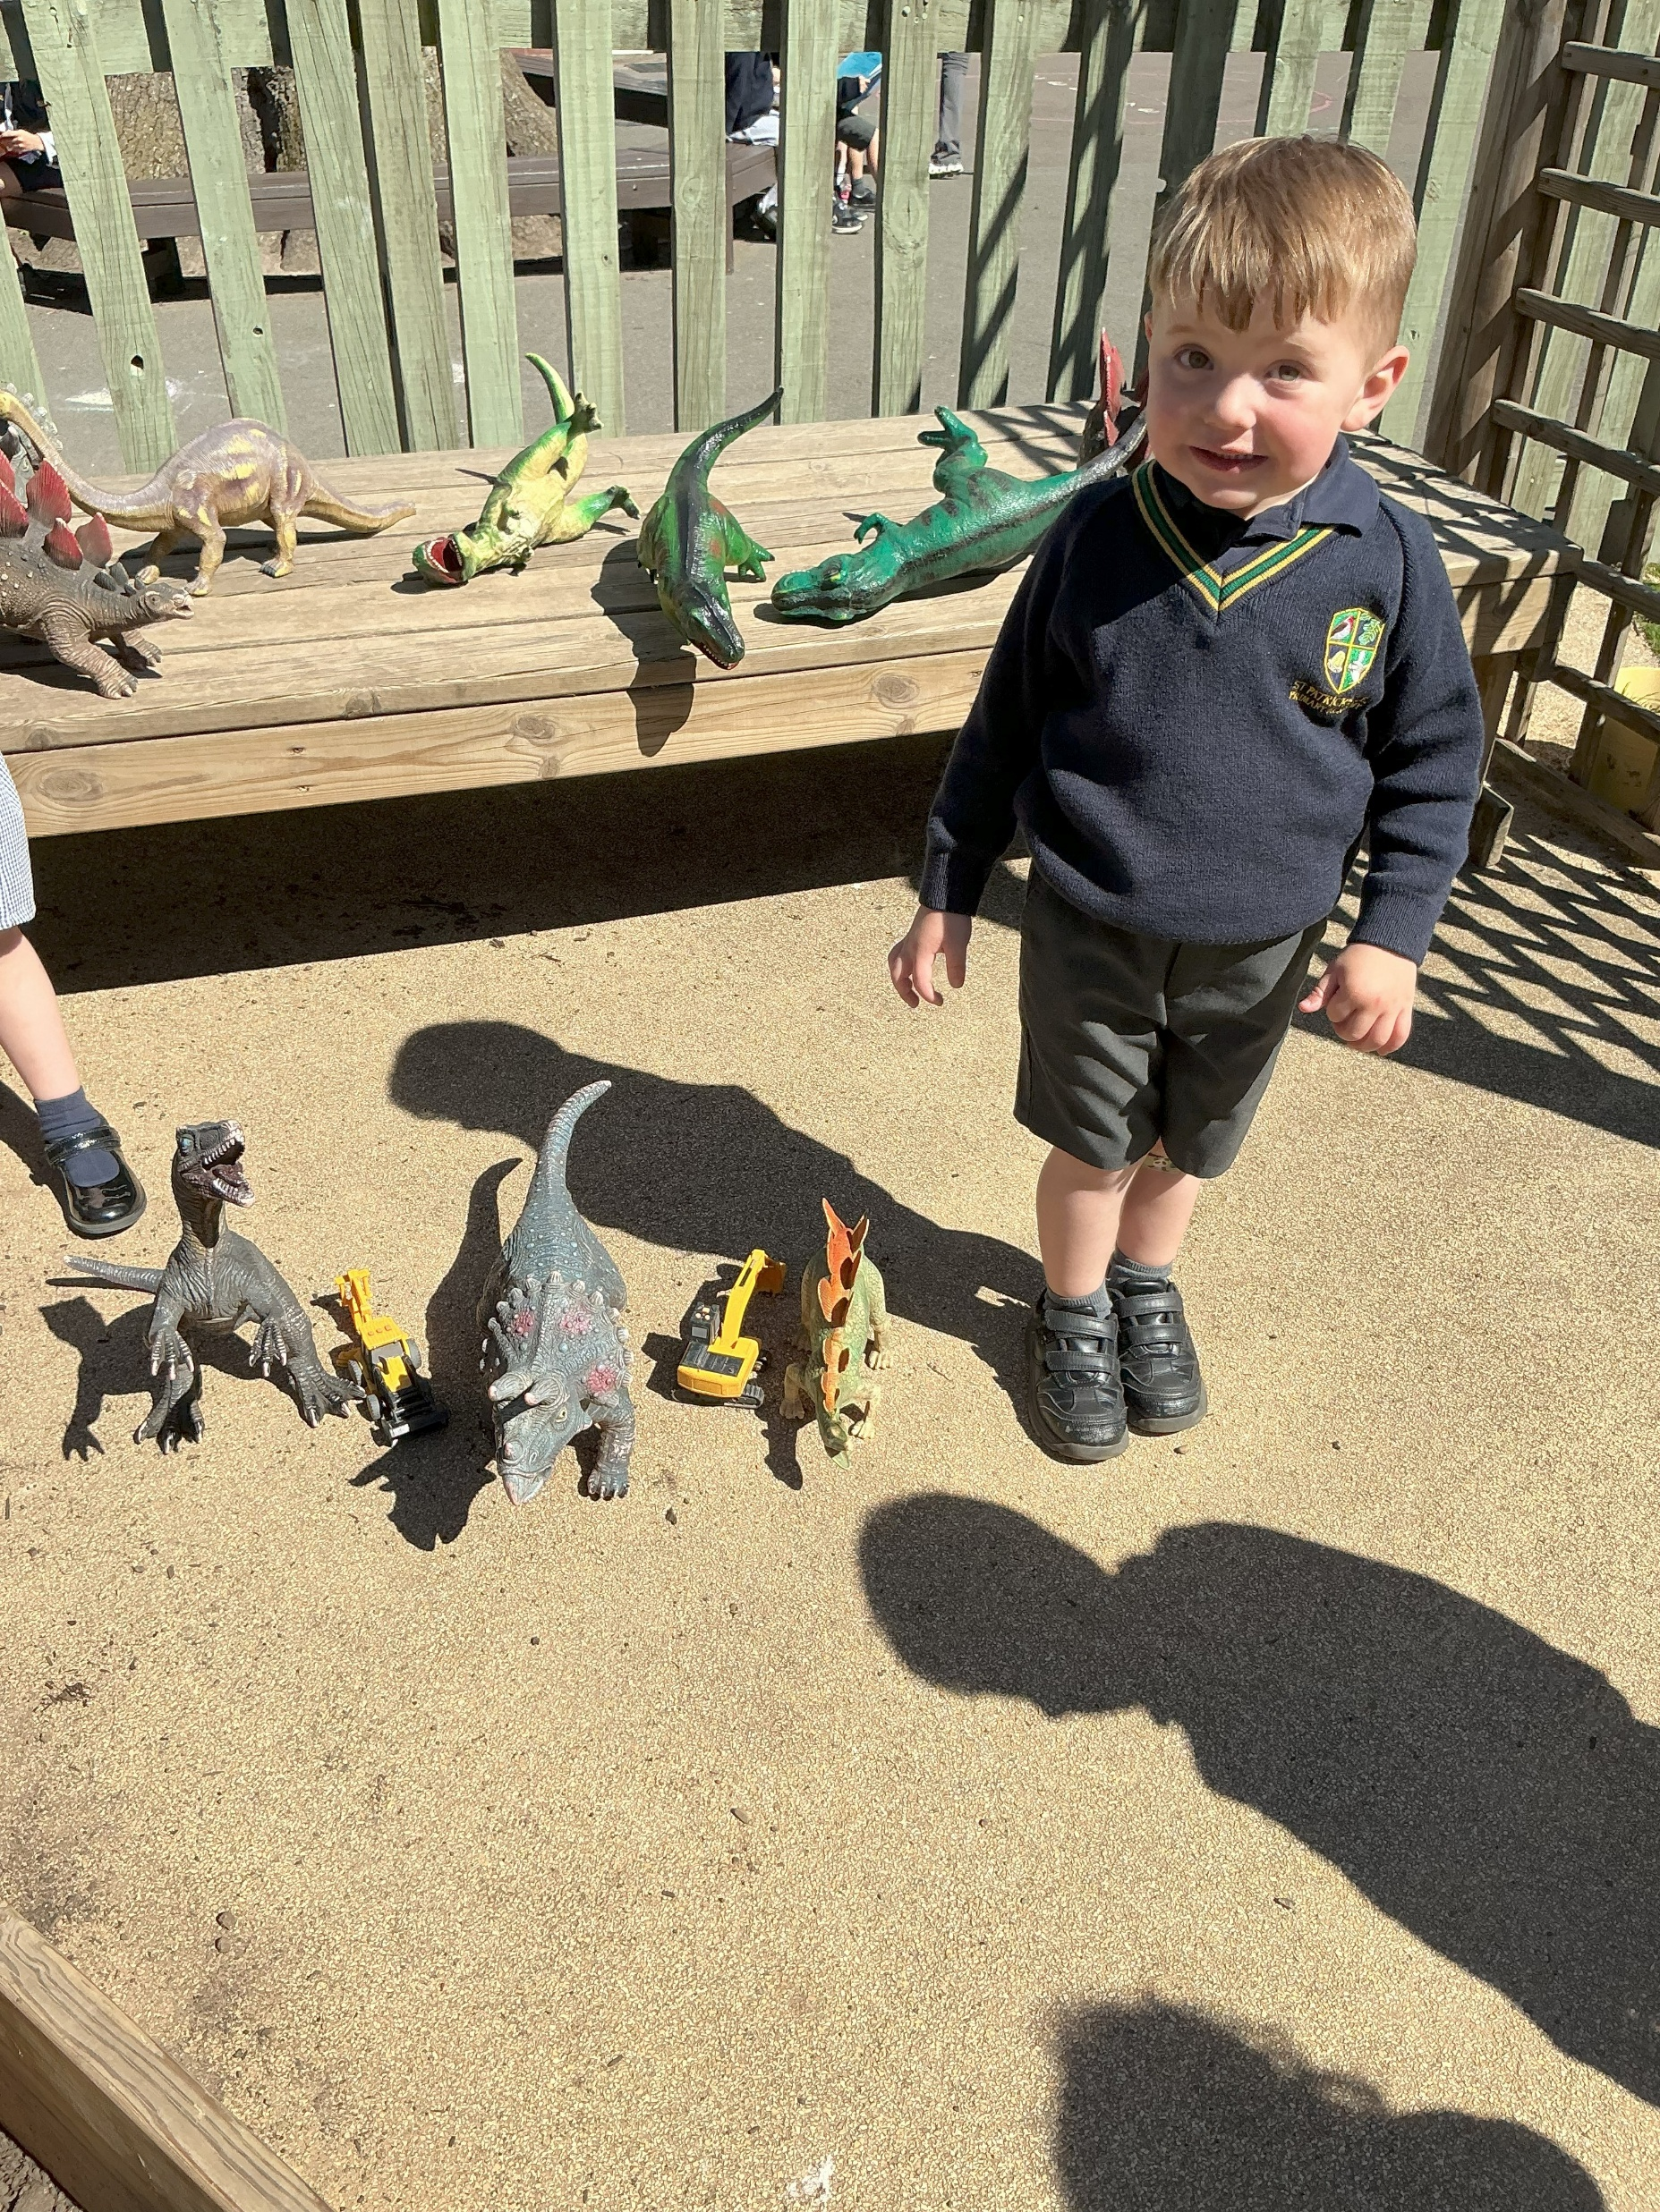
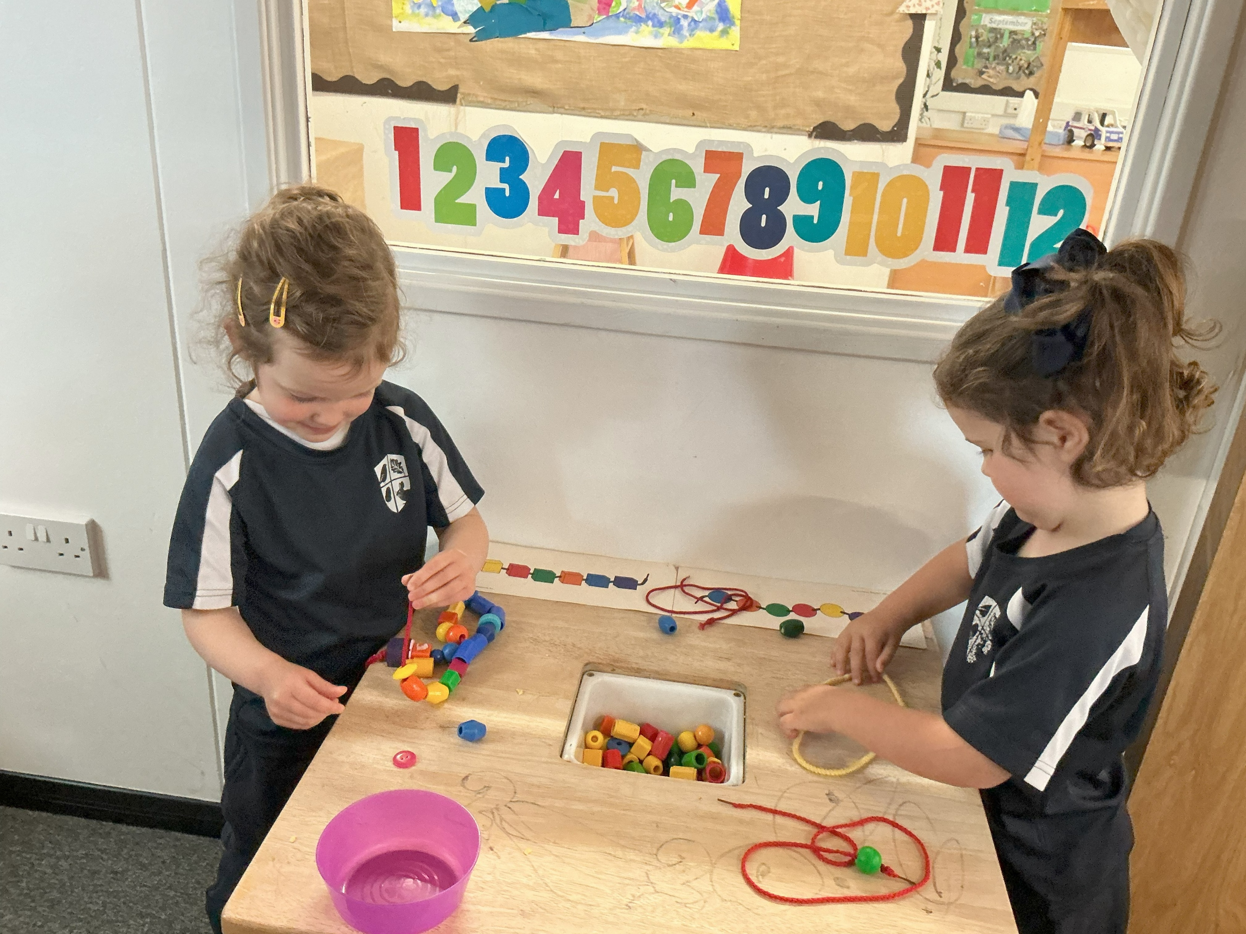
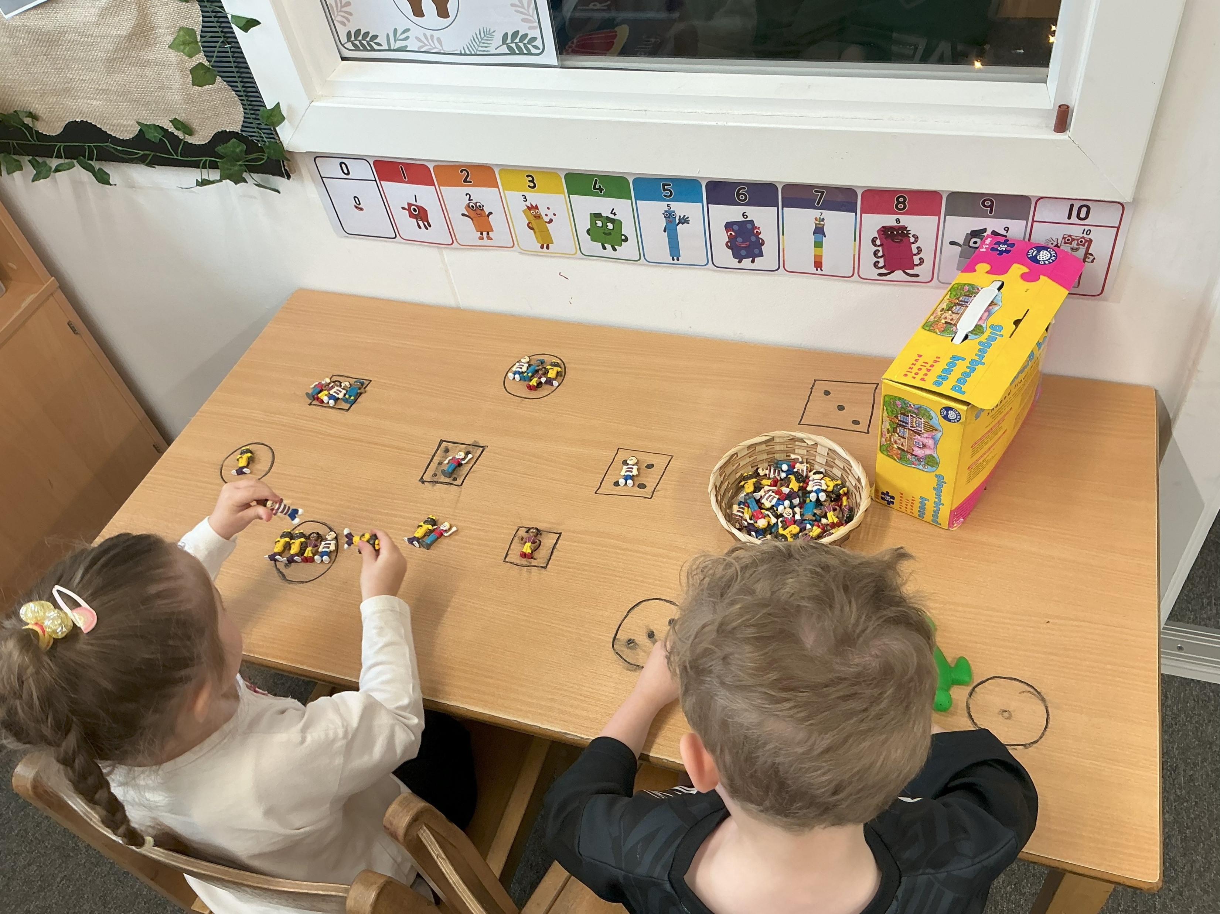
Mathematics
Number
Number patterns

Slide 11
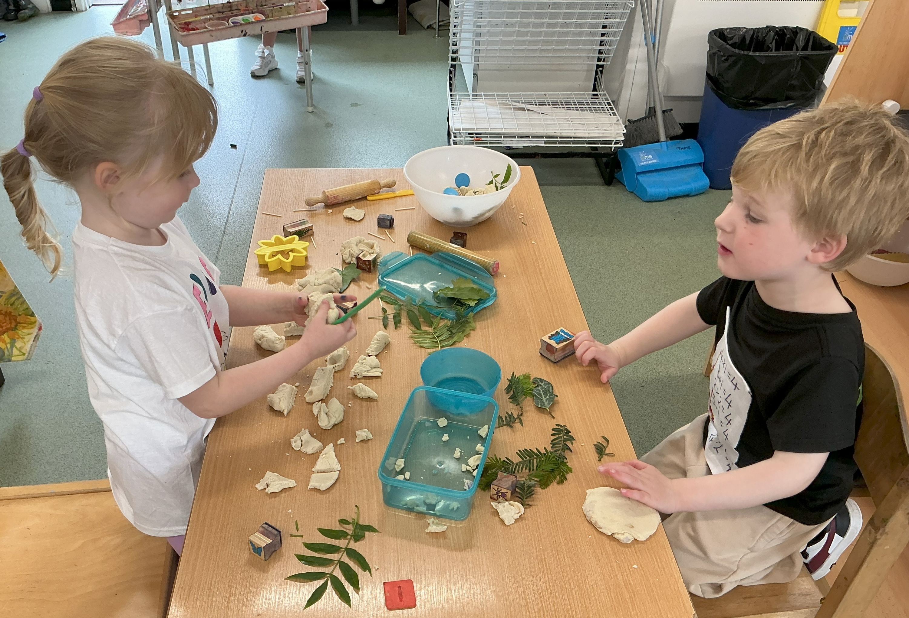
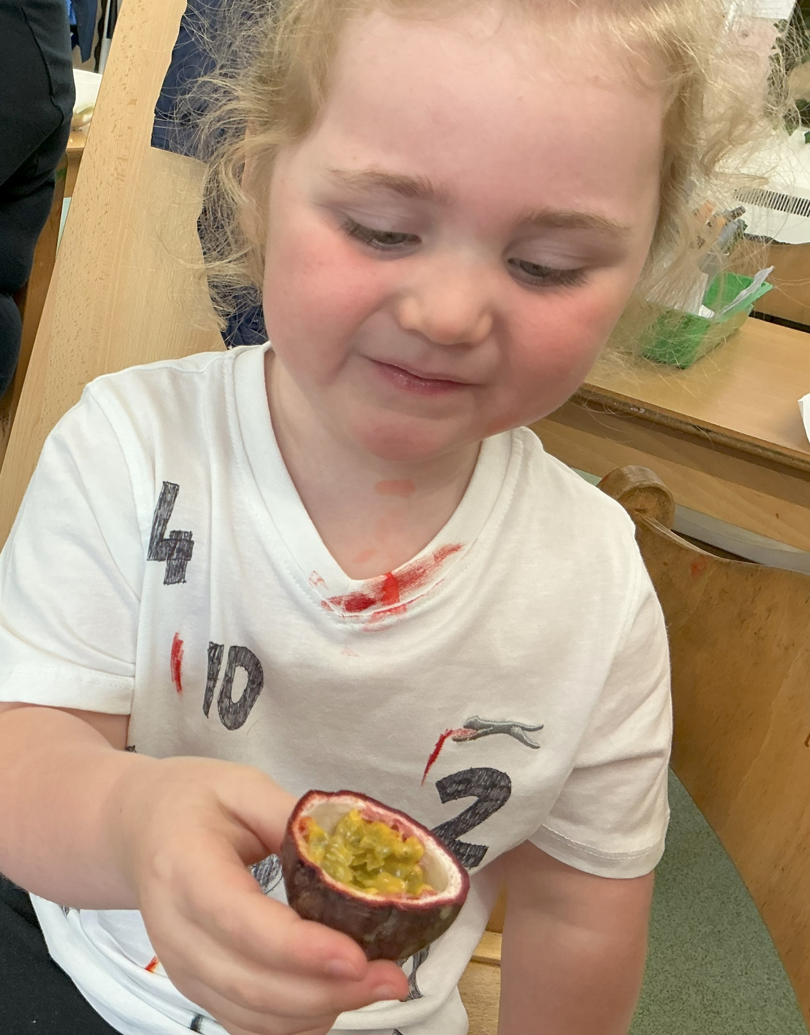
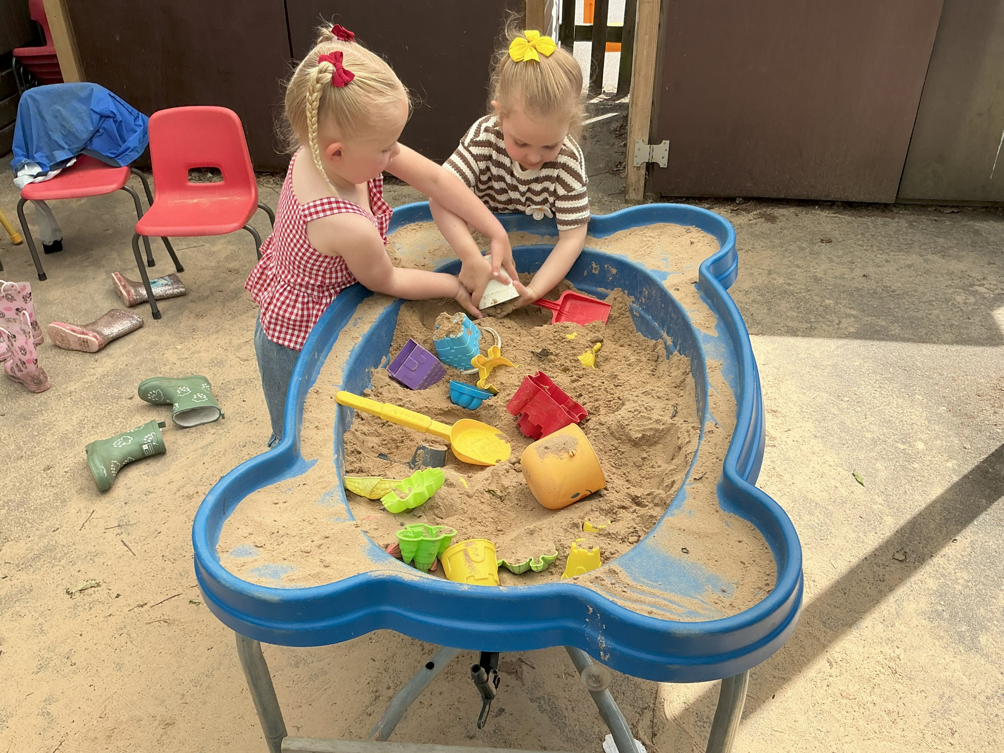
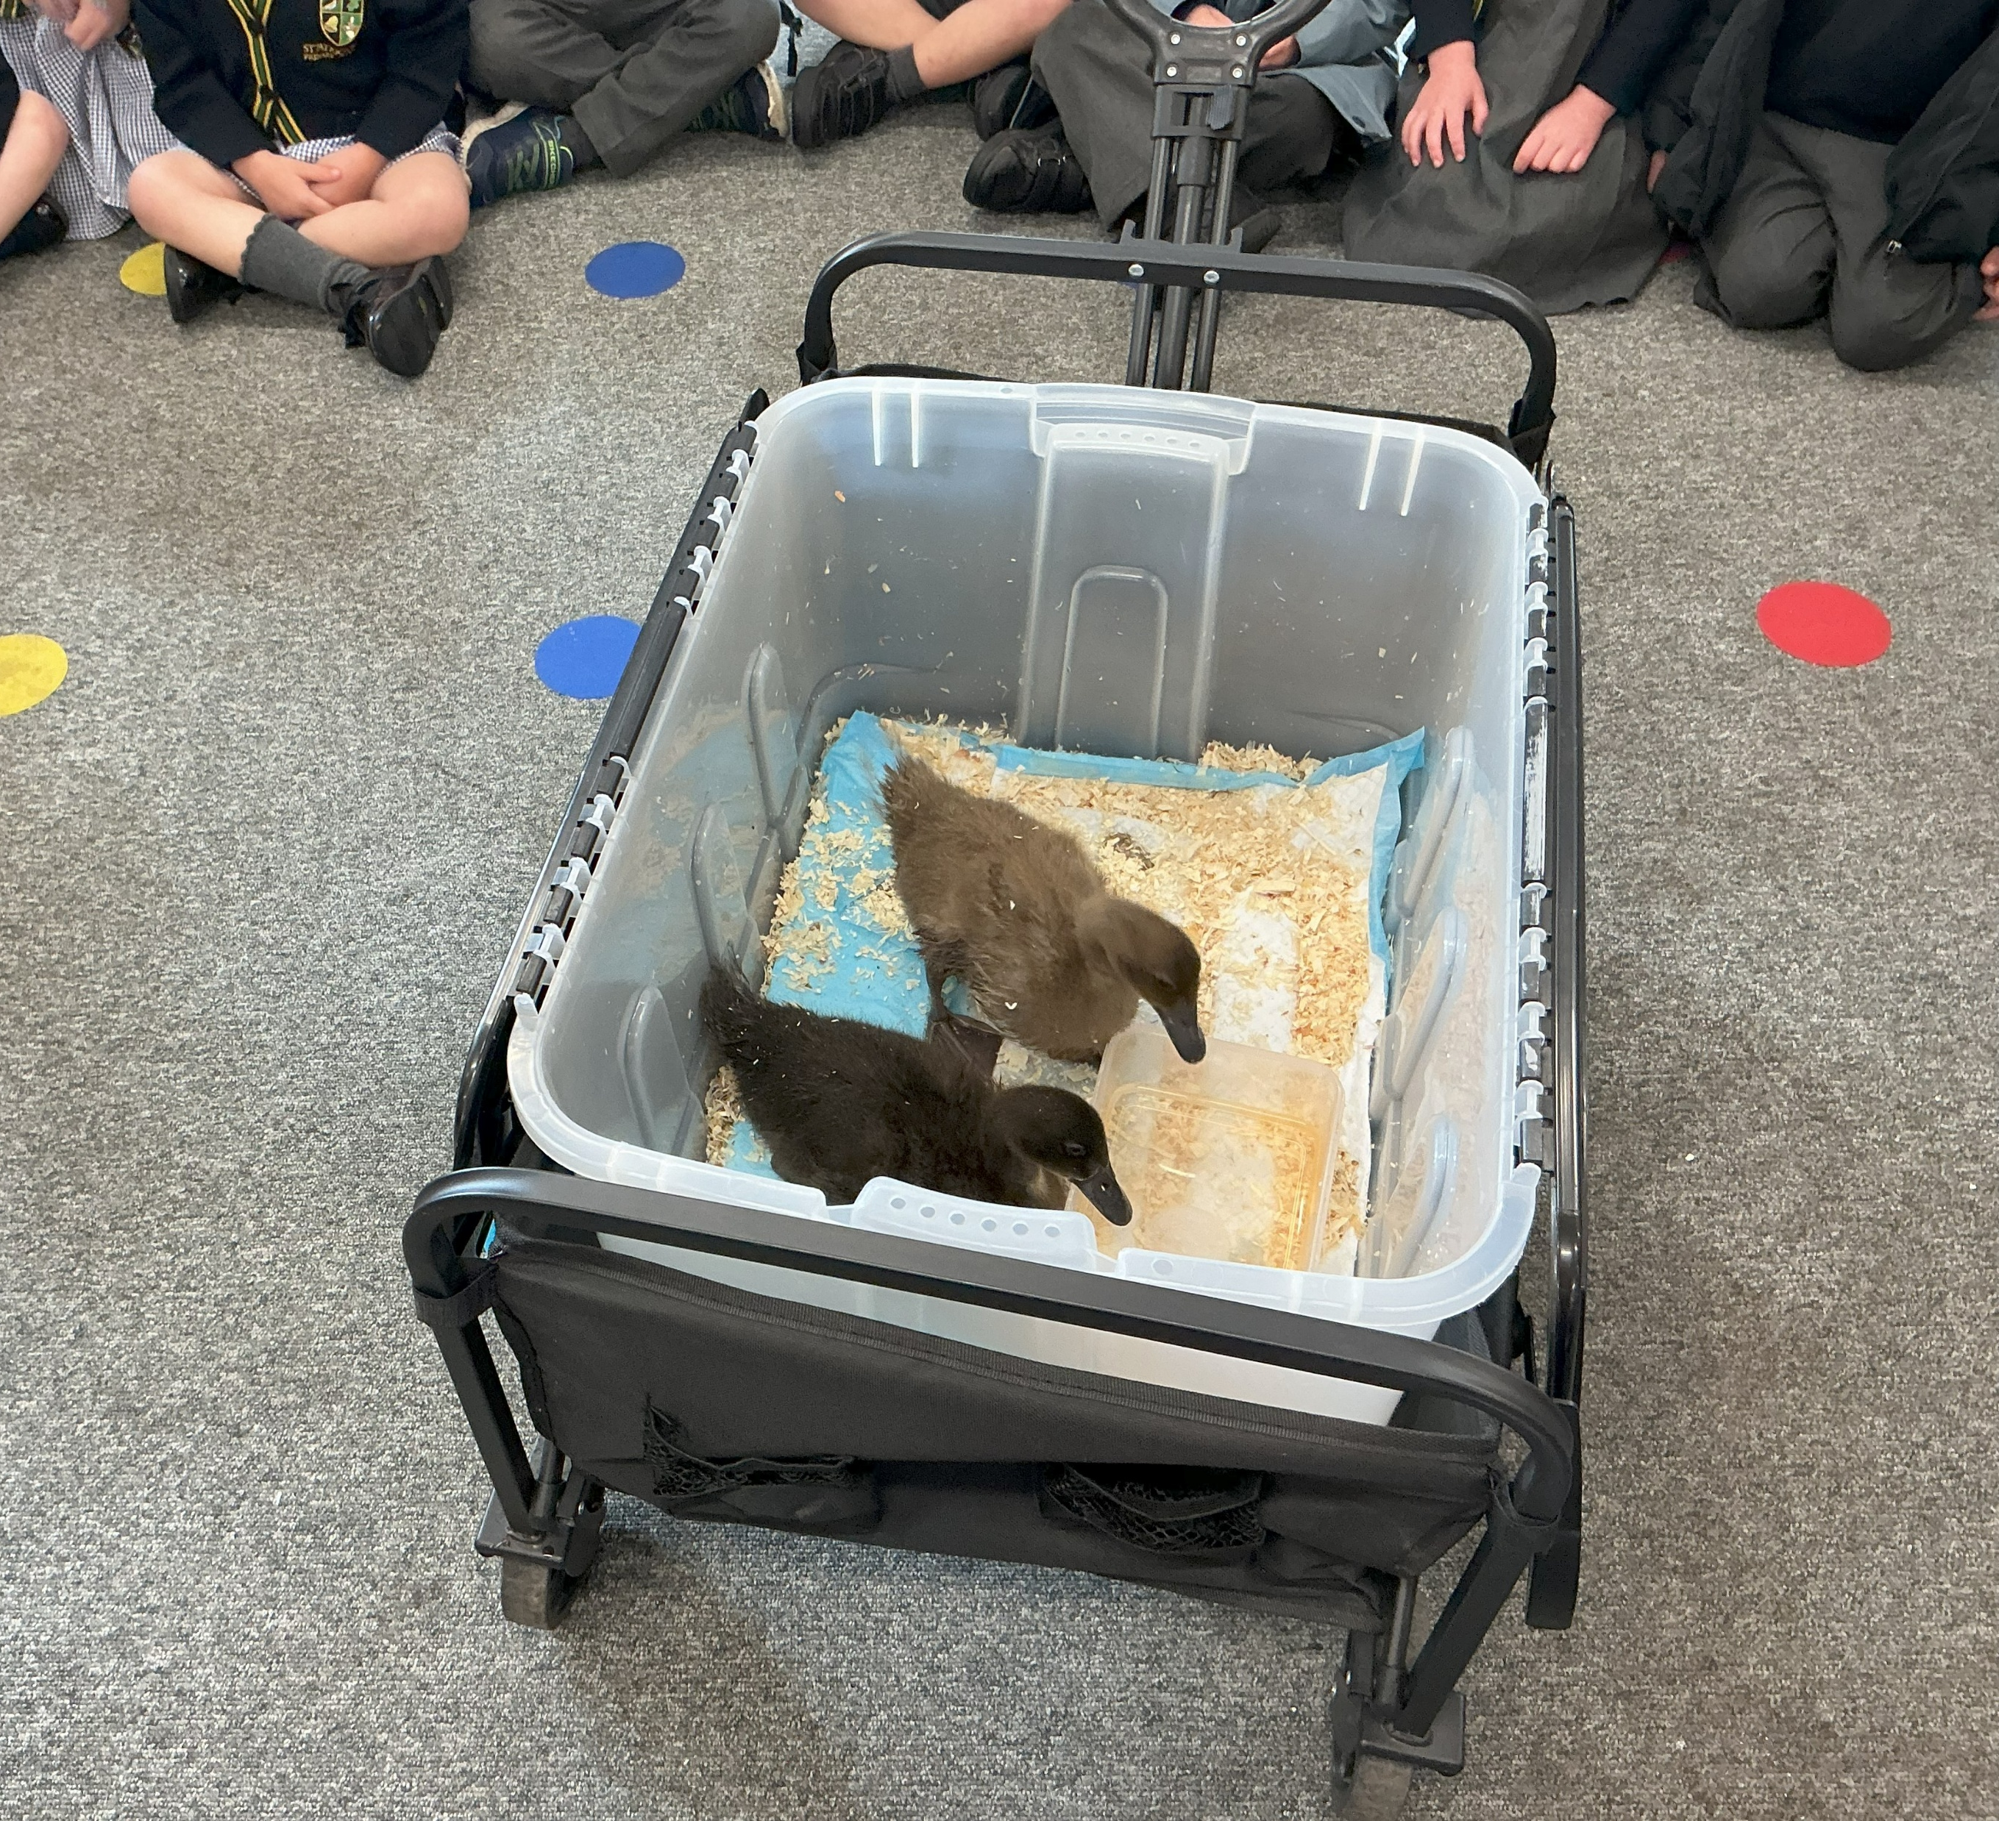
Understanding the World
Past and Present
People, Culture and Communities
The Natural World

Slide 12
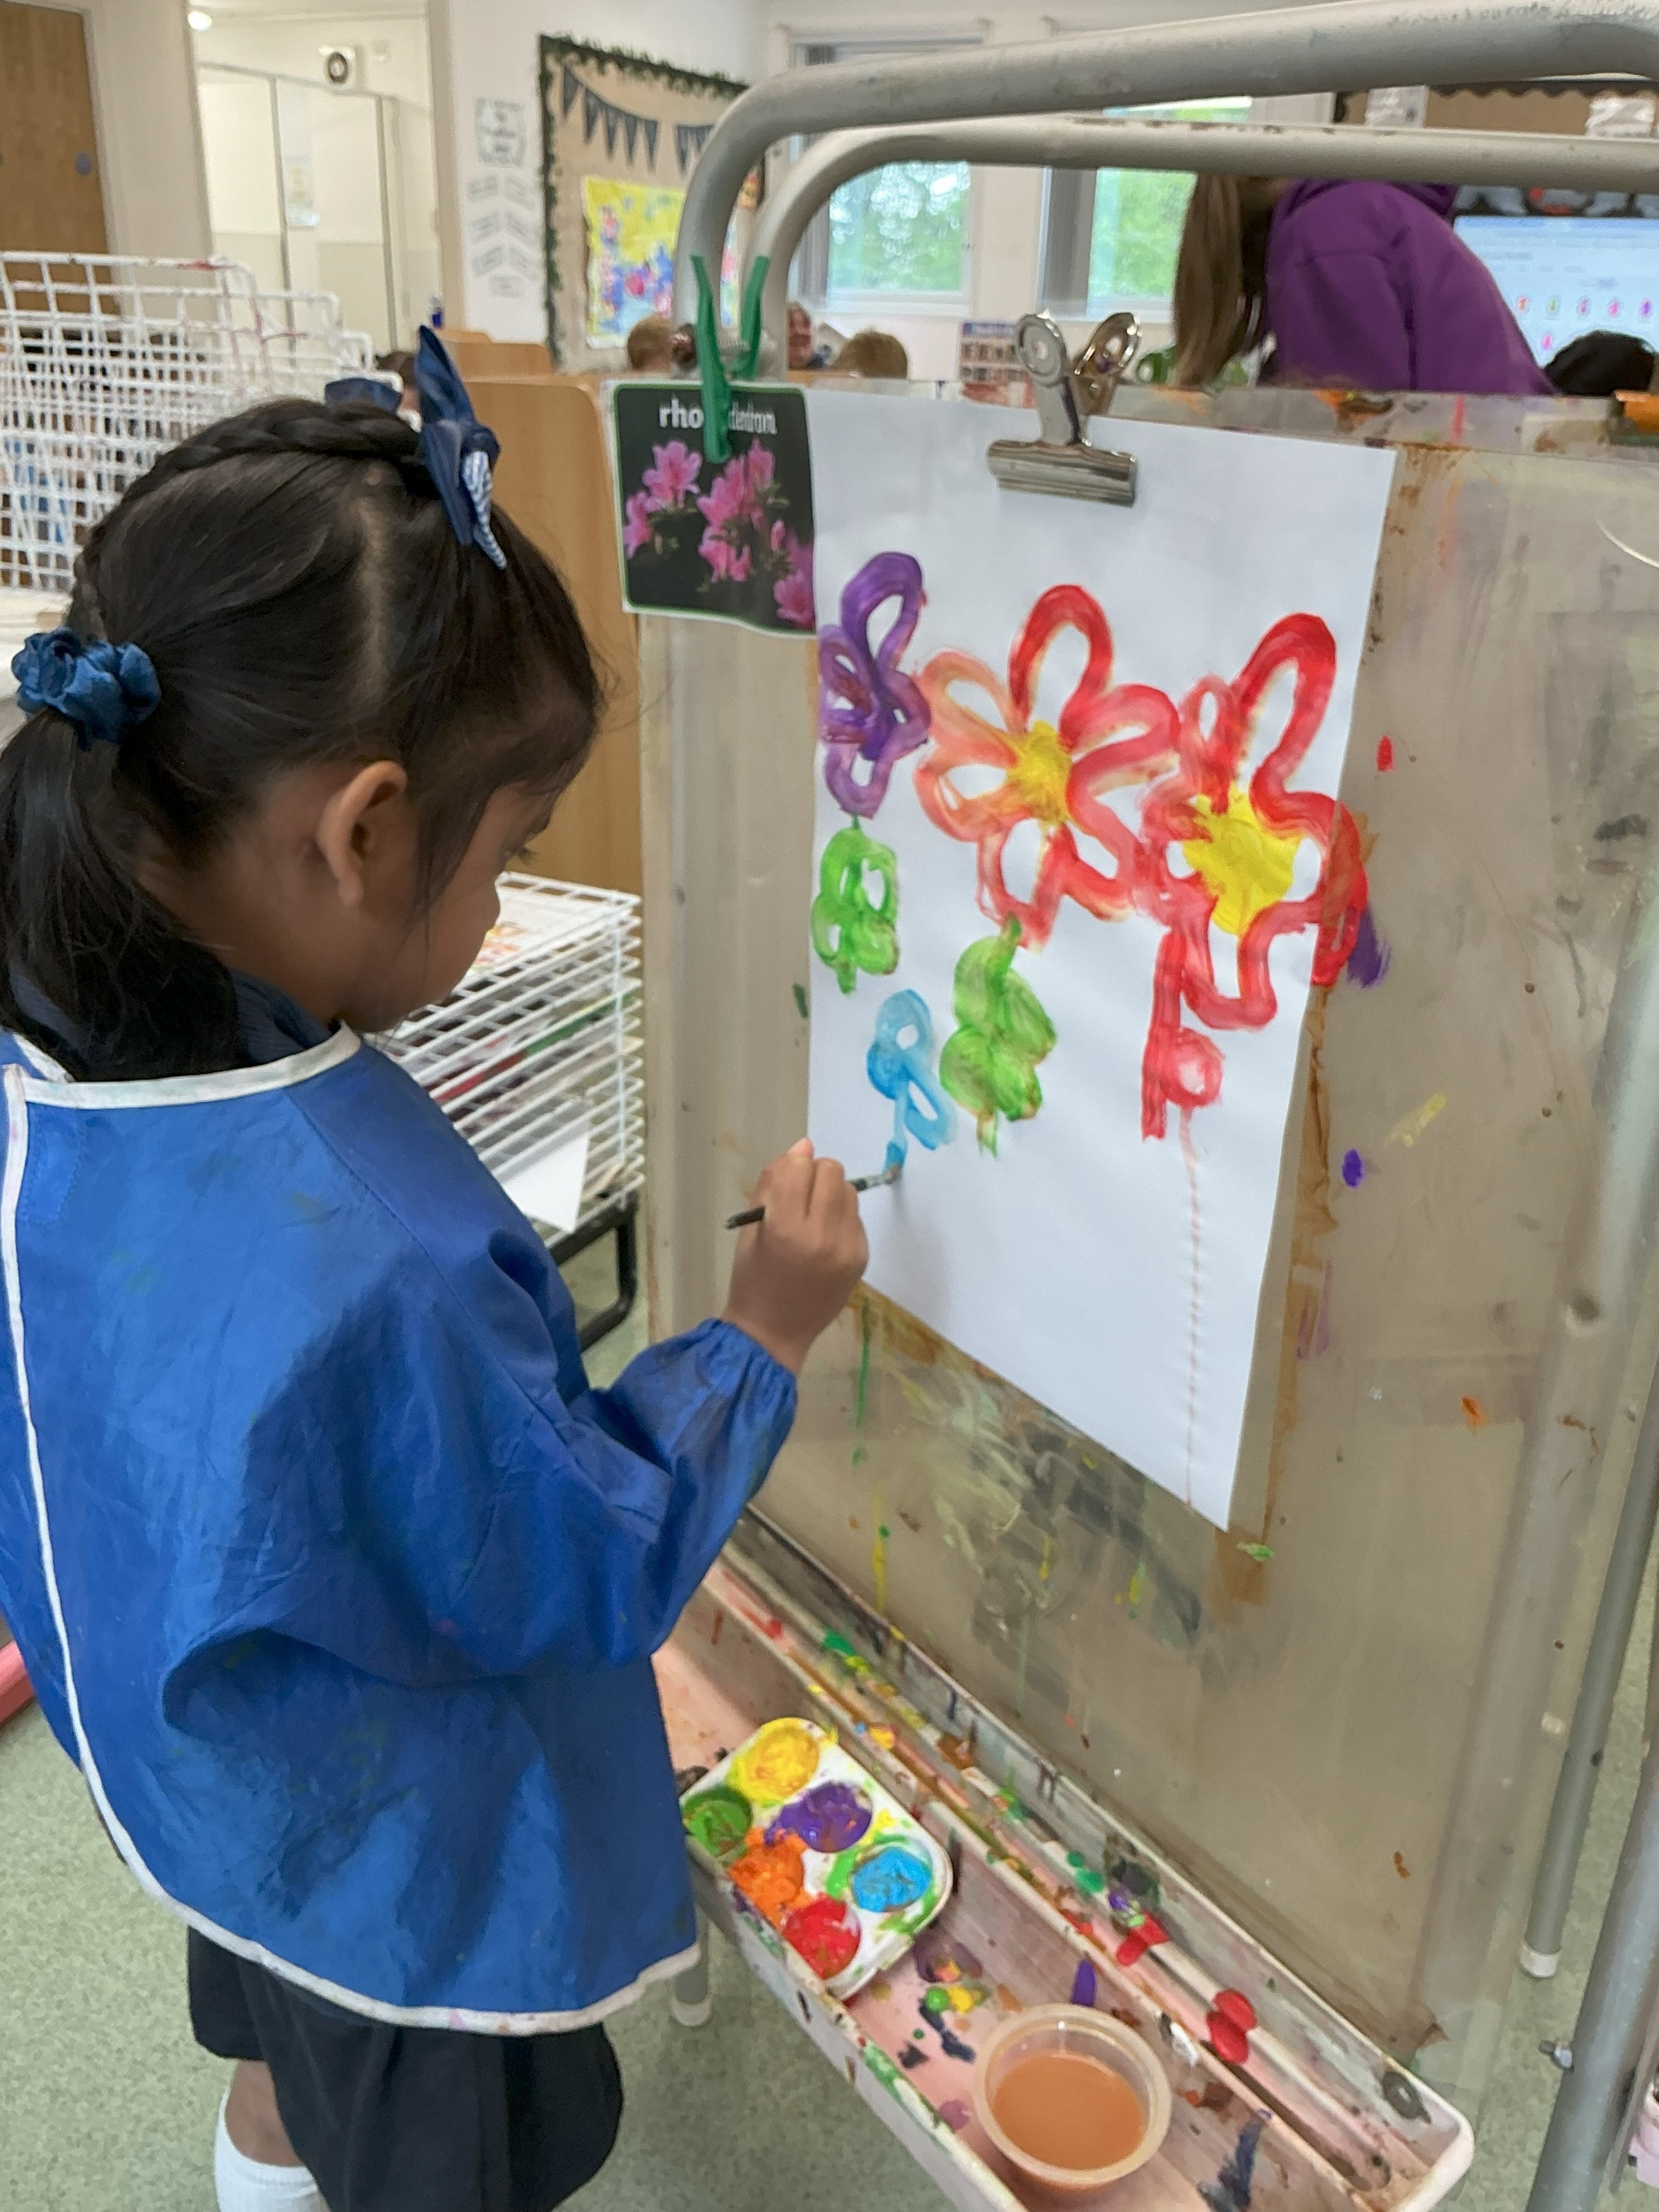
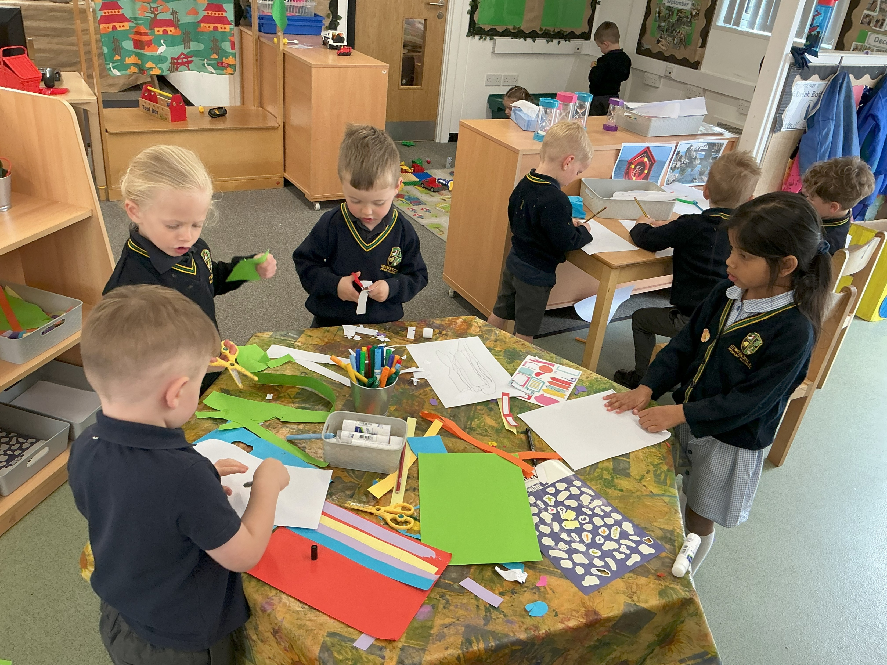
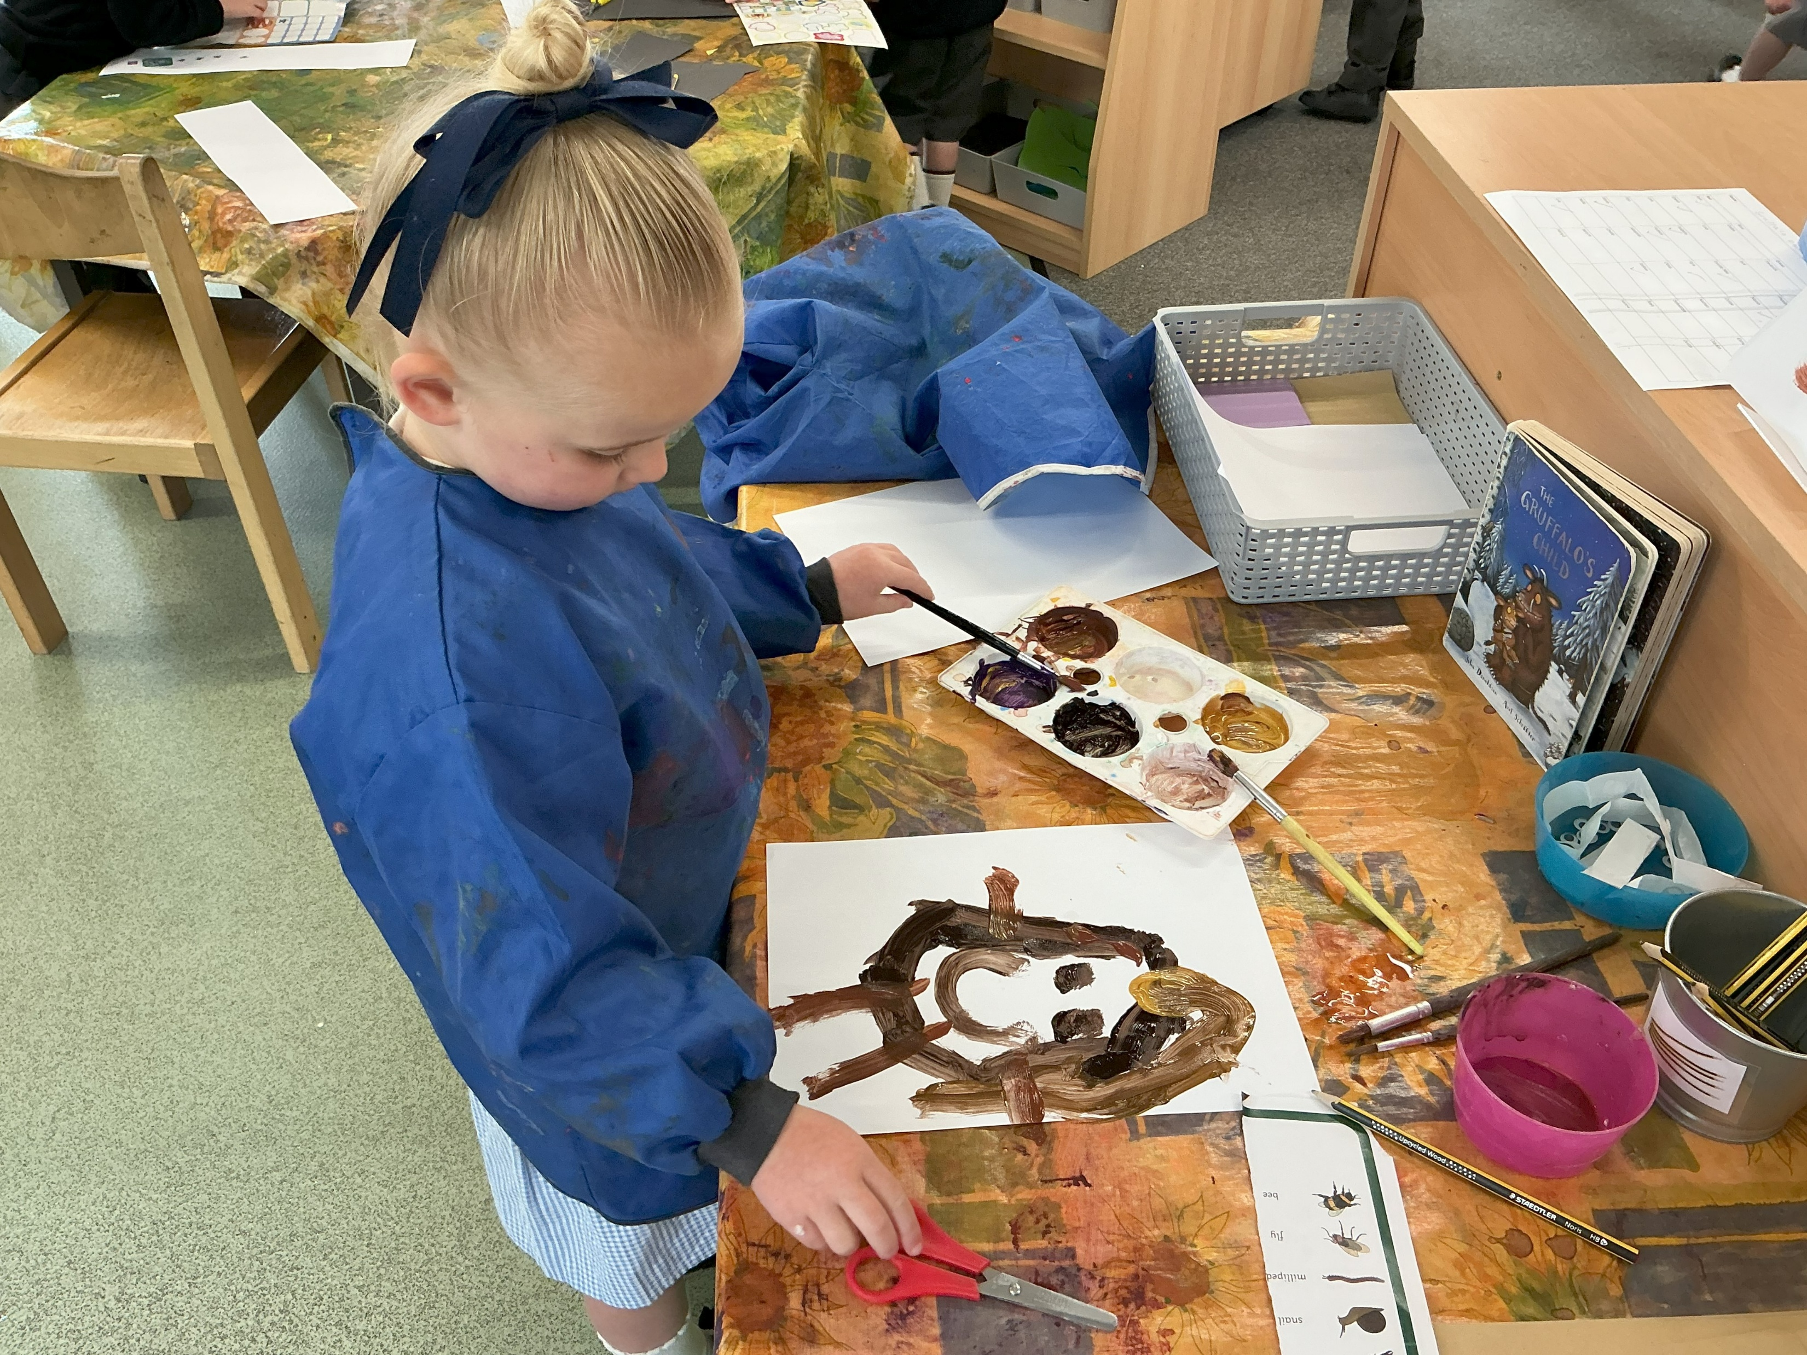
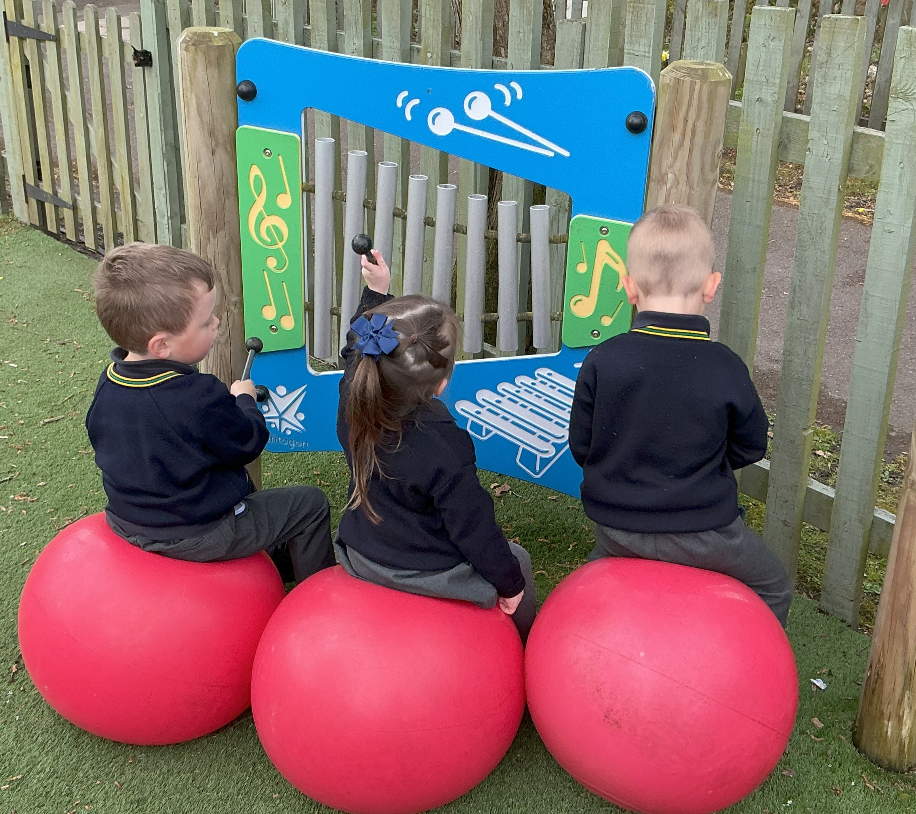
Expressive Arts & Design
Creative Development
Imagination

Slide 13






Nursery Themes
Autumn Term - Me and My Family / Traditional Tales
Spring Term – People Who Help Us / Amazing Animals
Summer Term – Places to Visit / Fantasy

Slide 14
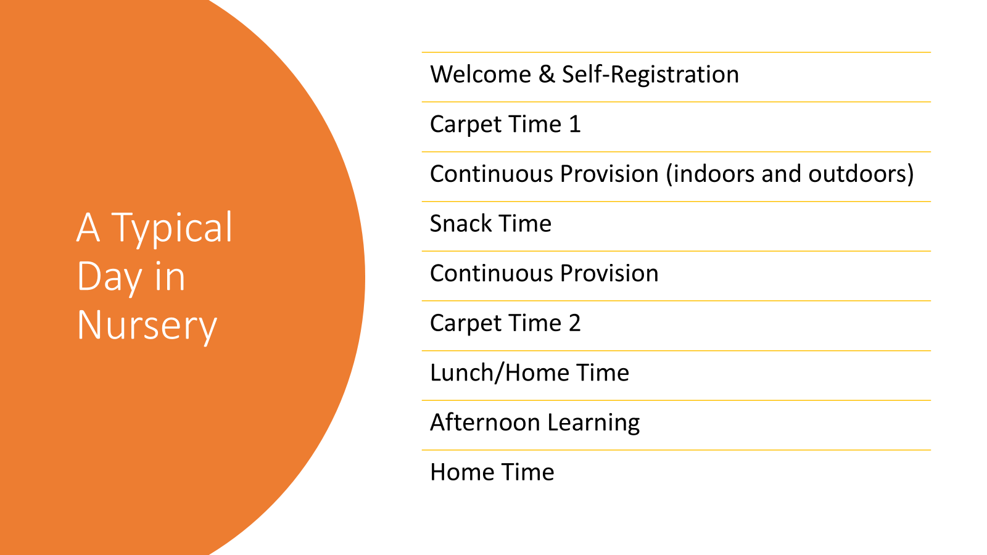

Slide 15

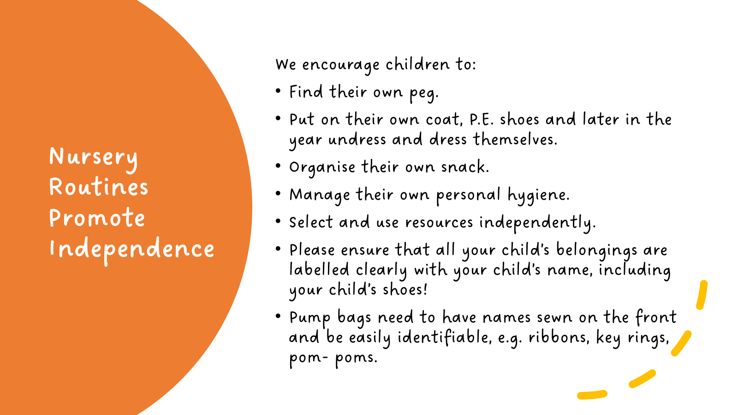
A Typical Day in Nursery

Slide 16
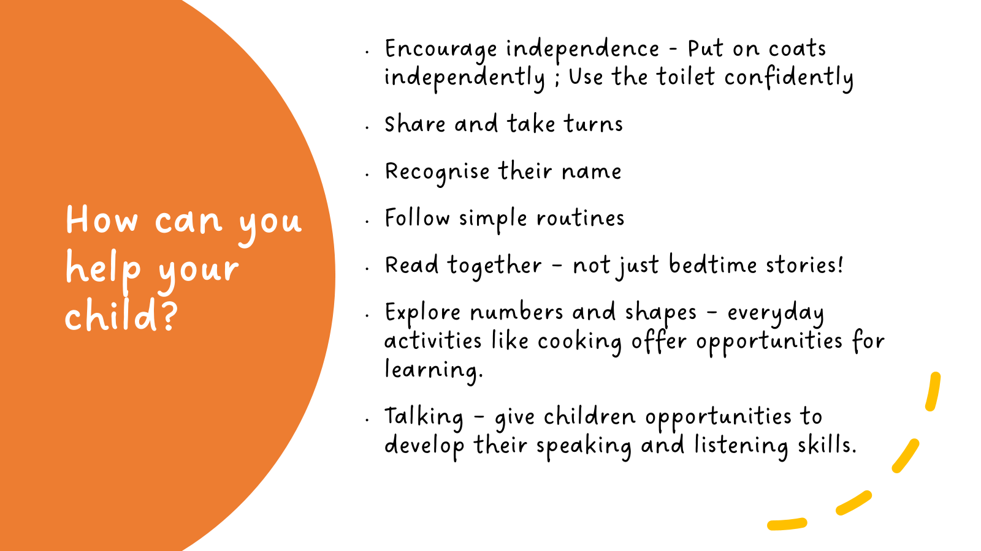
Nursery Routines Promote Independence

Slide 17

Settling In
Supporting a Positive Start
Key person support
Managing separation worries
Building routines
Transition visits

Slide 18
What will your child need?
SCHOOL UNIFORM including P.E. uniform. Your child should come to school in their P.E. kits on P.E. days. We will let you know which day once it has been confirmed.
WATERPROOF COAT – we try to go outside as much as possible
SPARE CLOTHES – please make sure you provide your child with a few spare clothes including pants and socks in case of play or toileting accidents. These should be kept in a P.E. bags on their pegs.
WELLIES – your child will need a pair of wellies to be kept in school for outdoor messy play, particularly the mud kitchen and the water play.
NAMED WATER BOTTLE – children should bring in a bottle of PLAIN WATER only
BOOK BAGS– children should have the flat flap-style book bag NOT a rucksack.
If your child is provided with any spare Nursery clothing please wash and return it as soon as possible.
Labelling plea !!!
Please ensure all your child’s belongings are labelled clearly with their name

Slide 19
Rewards and Behaviour
Children are rewarded with Dojo Points
Verbal praise is also given, along with stickers, stamps and class points.
Mrs Glennon may also choose children for lunch, hot chocolate or afternoon tea.

Slide 20

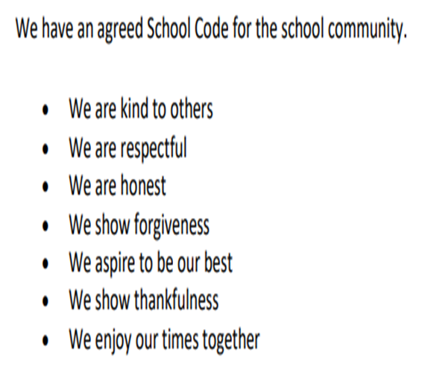
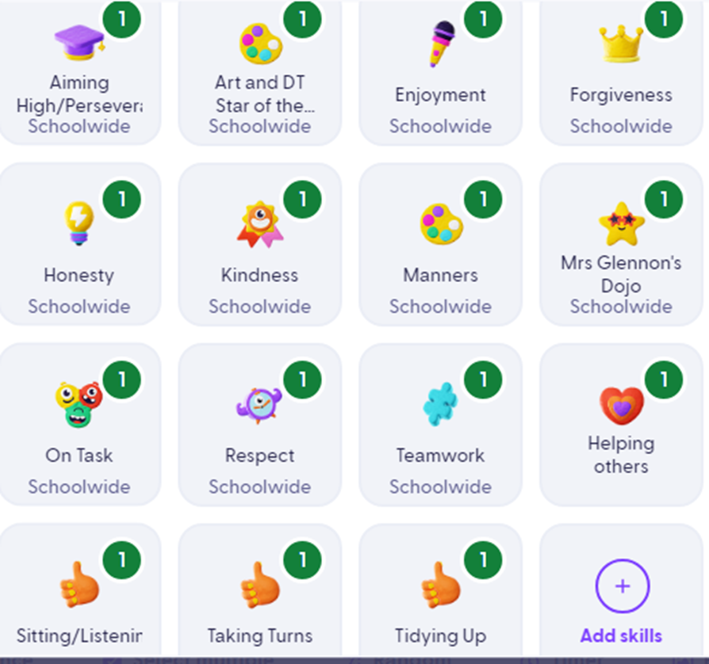
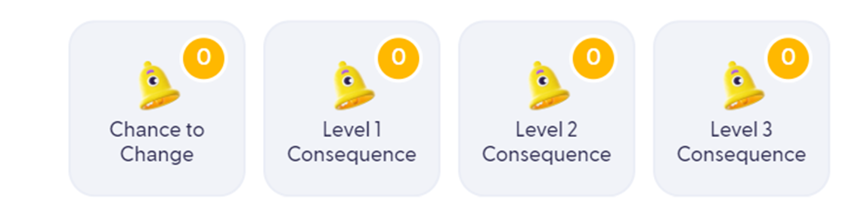
Class Dojo
Sanctions: children may receive a ‘Chance to Change’ for low level disruption.

Slide 21
Keeping Children Safe
Gates and collection procedures
Beginning and end of the day
Agreed people
Password
Attendance expectations
Online safety awareness

Slide 22

Home School Communication
Parent communication apps:
        Weduc
        Dojo
Newsletters and school website
Contact procedure - via the office
Weekly newsletter
WEBSITE – EYFS area
Book Bags
Parent consultations

Slide 23
Questions?
“We look forward to starting a new journey with you very soon!”

